Slide 1
A Novel Structural AR Modeling Approach for a Continuous Time Linear Markov System
Demeshko M., Washio T. and Kawahara Y.
Institute of Scientific and Industrial Research, Osaka University

Slide 2
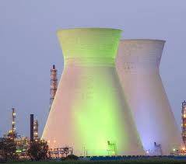
Introduction
≈
Continuous time, multivariate, stationary linear Markov system
Exactly represented
Discrete Autoregressive Moving Average (DARMA) model
≈
Approximated
Discrete Vector Autoregressive (DVAR) model
We focus on objective system exactly described by AR processes.

Slide 3
Introduction
DVAR model
Each mathematical relation in DVAR model doesn’t have a bijective correspondence to an individual process in the objective system.
Limitations
Not structural
Eq. 1
Process 1
Eq. 2
Process 2
…
…
We aim to analyse the mechanism of the objective system and DVAR model is not applicable for such analysis.
Eq. N
Process N
DVAR
model
System

Slide 4
The lack of structurality of DVAR model
DVAR model
Equations
u₁(t)+
u₂(t)+
u_{N}(t)+
…
…
Process 1
Process 2
They are equivalent for any regular Q,
where W(t)=QU(t).
…
Equations
w₁(t)+
w₂(t)+
w_{N}(t)+
Process N
…
…
System
where Φ_{j} are d×d coefficient matrices. U(t) is a d-dimensional unobserved noise vector.
The DVAR model doesn’t represent the system uniquely, since their correspondence depends on the choice of U(t).

Slide 5
VAR models structurality
DVAR model
Equations
u₁(t)+
u₂(t)+
u_{N}(t)+
…
…
Structural VAR model (unique P=Q)
Equations
Process 1
w₁(t)+
w₂(t)+
w_{N}(t)+
Process 2
…
…
…
where Ψ₀=I–P⁻¹, Ψ_{j}=P⁻¹Φ_{j,} W(t)=PU(t).
Structural
≈
Process N
Continuous time VAR (CTVAR) model
Equations
w₁(t)+
w₂(t)+
w_{N}(t)+
System
…
…
Each equation of the SVAR and CTVAR models have one-to-one correspondence to the system’s processes.
…

Slide 6
Related Work
Past SVAR modeling approaches required assumptions and domain knowledge .
Hyvärinen et al. 2008
Acyclic dependency
among variables in Y(t);
Non-Gaussianity of
noises;
All noises are mutually
independent.
Significantly limit the applicability of
the approaches.
We propose a new approach of SVAR and CTVAR modeling without any strong assumptions or domain knowledge on the objective system.

Slide 7
Research objectives
To show that a DVAR model uniquely represents the objective system, if the system is continuous time, multivariate, linear Markov system.
To clarify mathematical relations among a Continuous time VAR (CTVAR) model, a Structural VAR (SVAR) model and a DVAR model of the system.
To propose a new approach, CSVAR modeling to derive the CTVAR and the SVAR models by using the DVAR model obtained from observed time series data.
To demonstrate the accuracy and the applicability of CSVAR modeling using artificial and real world time series.

Slide 8
Proposed principle and algorithm

Slide 9
CTVAR model discrete approximation
Continuous time domain
CTVAR model
Process 1
Bijective
relation
Process 2
…
SVAR model
Process N
Discrete time domain
System
CTVAR model
High order finite difference approximation
This approximation is consistent.
Approximation error
when

Slide 10
Relation of CTVAR and SVAR models
Theorem 1
Under the assumption that objective system is stable and controllable
CTVAR and SVAR models have bijective correspondence.
Theorem 2
where S_{p}= –I.
where 1≤ m≤ p–1 and S_{p}= –I.

Slide 11
Relation of SVAR and DVAR models
Assuming that an objective system is continuous time, multivariate, linear Markov system represented by AR processes.
Relation of SVAR and DVAR models
CTVAR model is given
Lemma 1
SVAR model
Ψ_{j}=(I–Ψ₀)Φ_{j}
W(t) =(I–Ψ₀)U(t)
Bijective
relation
If a unique P, i.e., Ψ₀ are given.
Lemma 2
DVAR model
Φ_{j}=(I–Ψ₀)⁻¹Ψ_{j}
U(t) =(I–Ψ₀)⁻¹W(t)

Slide 12
Relation of SVAR and DVAR models
SVAR and DVAR models have bijective correspondence, because a unique Ψ₀, i.e., P, is given as follows.
Theorem 2
Lemma 1
Ψ_{j}=(I–Ψ₀)Φ_{j}
Theorem 1
By the constraints between CTVAR and SVAR,
we obtain a relation of SVAR and DVAR.
Theorem 3
P=I–Ψ₀=(–1)^{p+1}Δt^{-p}Φ_{p}⁻¹
Gives
SVAR model
DVAR model

Slide 13
CSVAR modeling algorithm
Y(t) data set
Estimate
Maximum-Likelihood method
DVAR model
Derive
Lemma 1 and Theorem 3
SVAR model
Derive
Theorem 2
CTVAR model

Slide 14
Numerical Performance Evaluation Using Artificial simulation data
CTVAR
model
SVAR
model
DVAR
model
Generate
S
Ψ
Φ
Compare
Artificial
DVAR data set
MATLAB
estimation
S*
Ψ*
Φ*
Parameters generation using provided relations

Slide 15
Artificial data generation
Each element of S_{m} is a uniformly distributed random value in the interval (–1.5, 1.5) , for given AR order p, dimension d, number of data points N .
CTVAR model
S_{m} (m=0,…,p–1)
SVAR model
Ψ_{j} (j=0,…,p)
Estimated from S_{m} by Theorem 1.
DVAR model
Φ_{j} (j=1,…,p)
Estimated from Ψ_{j} by Lemma 2.
Check the stability and the controllability
Generate
DVAR
data set
Where U(t) is independently distributed Gaussian time series with zero mean value, standard deviation from [0.3, 0.7].

Slide 16
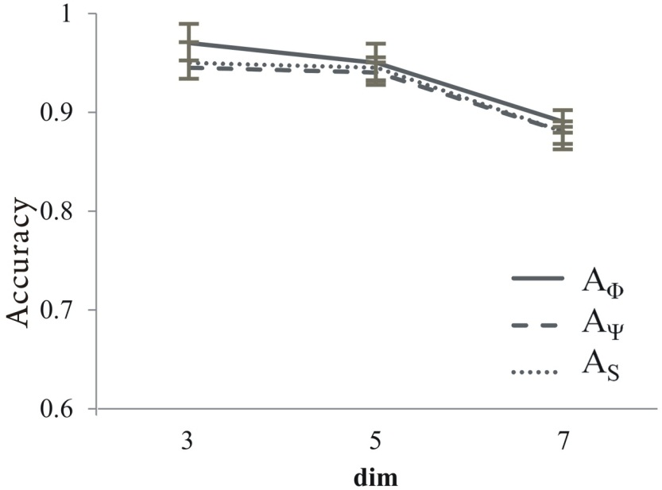
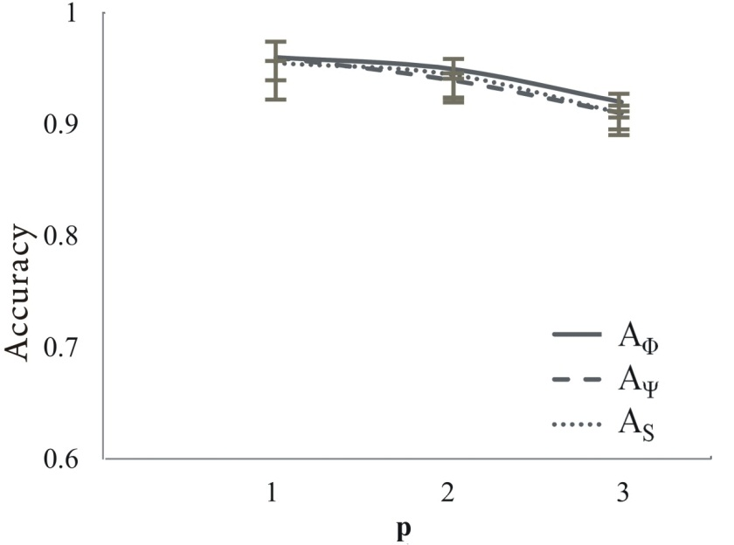
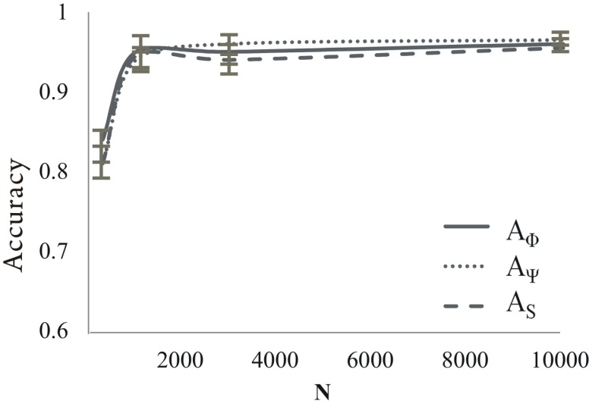
Accuracies evaluation
Accuracy
Accuracy
d
p
Over different dimensions d, when N=1000, and р=2.
Over different AR orders p, when d=5 and N=1000.
Accuracy
N
Over different numbers of data points N, when d=5 and р=2.

Slide 17
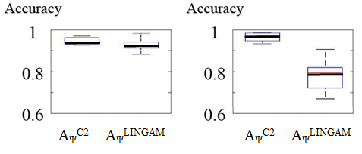
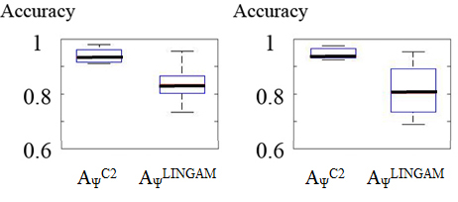
Comparison with AR-LiNGAM method
AR-LiNGAM is a past representative SVAR modeling method.
(a) non-Gaussian and acyclic
(b) non-Gaussian and cyclic
d=5, N=1000,
p=2 and q=2.
(c) Gaussian and acyclic
(d) Gaussian and cyclic

Slide 18
Performance demonstration in practical application
Nuclear Reactor IBR-2
situated in JINR, Dubna.
1.2 m
Reactor body
Reactor core
Stationary
reflector
4.5 m
Main neutron
reflector
Moderator
Additional
neutron
reflector
Peak pulse power 1500 МW
Pulse Frequency 5 Hz

Slide 19
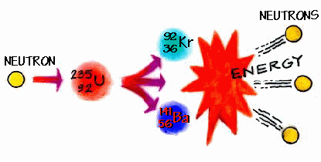
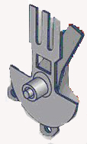
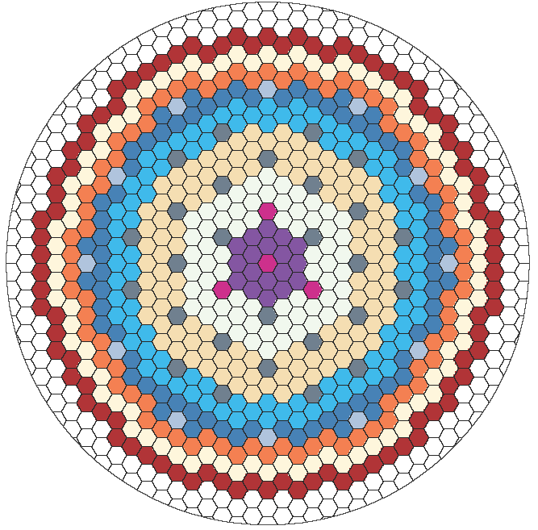
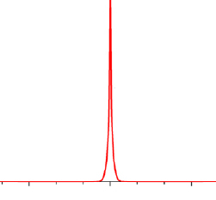
Performance demonstration in practical application
Axial deviations of the additional reflector (X_{A})
Axial deviations of the main reflector (X_{Q})
Neutrons
Reactor core
Energy of power
pulses Q

Slide 20
Performance demonstration in practical application
SVAR
CTVAR
Q X_{Q} X_{A}
Q X_{Q} X_{A}
Q X_{Q} X_{A}
Q X_{Q} X_{A}
Q X_{Q} X_{A}

Slide 21
Performance demonstration in practical application
DVAR
Q X_{Q} X_{A}
?
Q X_{Q} X_{A}

Slide 22
Conclusion
We showed that the DVAR model uniquely represents the continuous time, multivariate, linear Markov system.
We clarified mathematical relations between the CTVAR, the SVAR and the DVAR models.
Proposed modeling approach accurately derives the CTVAR and the SVAR models from the DVAR model under a generic assumption.
We demonstrated the practical performance of our proposed approach through some numerical experiments using both artificial and real world data.

Slide 23
References
[1] P.J. Brockwell and R.A. Davis, “Time Series: Theory and Methods”, Springer, 2nd ed., 1991.
[2] O. Stamer, R.L. Tweedie and P.J. Brockwell, “Existence and Stability of Continuous Time Threshold ARMA Process”, Statica Sinica, Vol.6, 1996, 715-732.
[3] J. Gottschalk, “An Introduction into the SVAR Methodology: Identification, Interpretation and Limitations of SVAR models”, Kiel Working Paper, No.1072. Institute of World Economics, Kiel, 2001.
[4] A. Moneta, D. Entner, P. O. Hoyer and A. Coad. Causal inference by independent component analysis: Theory and applications. Oxford Bulletin of Economics and Statistics, 75(5): 705-730, 2013..
[5] A. Hyvärinen, S. Shimizu and P. Hoyer, “Casual Modeling Combining Instantaneous and Lagged Effects: an Identifiable Model Based on Non-Gaussianity”, Proceedings of the 25th International Conference on Machine Learning, Helsinki, Finland, 2008, 424-431.
[6] B. Pfaff and T. Kronberg, “VAR, SVAR and SVEC Models: Implementation within R Package vars”, Journal of statistical software, Vol.27, No.4, 2008, 1-32.
[7] L. Kilian, “Structural Vector Autoregressions, Handbook of Research Methods and Applications on Empirical Macroeconomics”, Edward Elger, 2011.
[8] J. Pearl, "Causality: Models, Reasoning, and Inference", Chap.1 and Chap.5, Cambridge University Press, 2000.
[9] F. Fisher, “A Correspondence Principle for Simultaneous Equation Models”, Econometrica, Vol. 38, № 1, 1970, 73-92.
[10] Y. Iwasaki and H.A. Simon, “Causality and Model Abstraction”, Articial Intelligence, Vol.67, 1994, 143-194.

Slide 24
References
[11] G. Lacerda, P. Spirtes, J. Ramsey, and P. O. Hoyer, “Discovering cyclic causal models by independent components analysis, Proceedings of the 24th conference on Uncertainty in Artificial Intelligence, 2008.
[12] J.M. Mooij, D. Janzing and B. Scholkopf, “From Ordinary Differential Equations to Structural Causal Models: the deterministic case”, Proceedings of the 29th conference on Uncertainty in Artificial Intelligence, 2013.
[13] Y. Kawahara, S. Shimizu and T. Washio, “Analyzing Relationships between ARMA Processes Based on Non-Gaussianity of External Influences”, Neurocomputing, Vol. 74, № 12-13, 2011, 2212-2221.
[14] R.J. LeVeque, “Finite Difference Methods for Ordinary and Partial Differential Equations: Steady-state and Time-dependent Problems”, SIAM e-books, 2007.
[15] P. Olver, “Applications of Lie groups to differential equations”, Springer, New-York, 1993, 318.
[16] B. L. Shea, “Estimation of multivariate time series”, Journal of Time Series Analysis, Vol. 8, 1987, 95–110.
[17] S. Shimizu, T. Inazumi, Y. Sogawa, A. Hyvärinen, Y. Kawahara, T. Washio, P. O. Hoyer and K. Bollen, “DirectLiNGAM: A direct method for learning a linear non-Gaussian structural equation model”, J. of Machine Learning Research, Vol. 12, 2011, 1225-1248.
[18] Yu. N. Pepyolyshev, “Spectral characteristics of power noise parameters and fluctuations of neutron reflectors of nuclear reactor IBR-2”, Preprint, JINR, Dubna (in Russian), 1988.
[19] M. Voortman, D. Dash and M.J. Druzdzel, "Learning Why Things Change: The Difference-Based Causality Learner", Proceedings of the 26th conference on Uncertainty in Artificial Intelligence, 2010

Slide 25
Thank you for your attention

