Slide 1
Prior Knowledge Driven Causality Analysis in Gene Regulatory Network Discovery
Authors: Shun Yao, Shinjae Yoo, Dantong Yu
Stony Brook University
Computational Science Center, Brookhaven National Laboratory
Presenter: Shun Yao

Slide 2
Overview
Motivation
Challenges & Methods
Experiments
Contributions

Slide 3
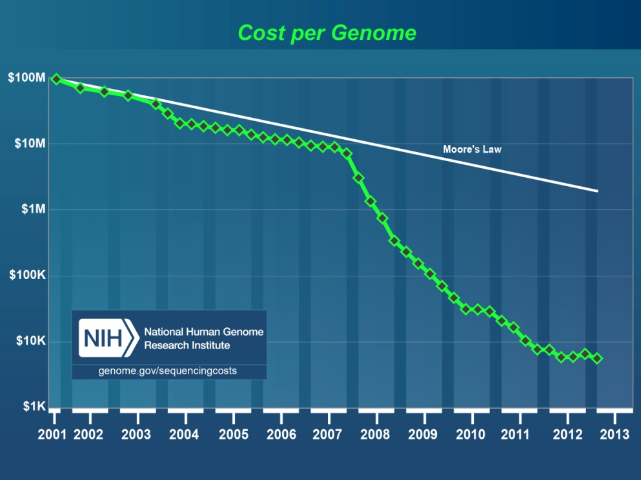
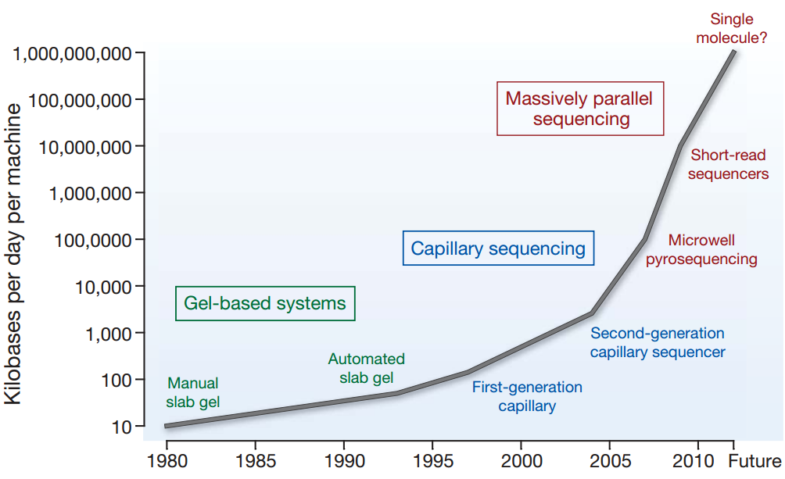
Next Generation Sequencing: Data explosion
Speed improvements in DNA seq
Cost improvements in DNA seq
Analyzing the data systematically has become a challenge.
Nature 458, 719-724 (2009)
Notes:
Bioinformatics have becomes more important than before.
Super Moore law speed.

Slide 4
Time Series Gene Expression Data
Biological process from a systematic perspective
Domain question: How do different genes coordinate with each other to make a process happen?
Cell cycle
Developmental biology
Or anything
What to do experimentally?
Time Series Gene Expression Data through microarray or sequencing.
Find the regulatory relationships from the data.
Bioinformaticians’ job to analyze the time series gene expression data
Notes:
This is today’s main topic.

Slide 5
Overview
Motivation
Challenges & Methods
Experiments
Contributions

Slide 6
Granger causality modeling
Granger causality modeling:
Originated from time series analysis in economics.
One of the most popular vector autoregressive (VAR) models.
Results could be statistically analyzed.
Bivariate Granger Causality modeling
Pairwise Granger Causality (PGC)
General strategies
Multivariate Granger Causality modeling
Conditional Granger Causality (CGC)
Notes:
Granger causality model: PGC or CGC, bivariate or multivariate

Slide 7
Bivariate Granger Causality model (PGC)
Two time series x_{t} and y_{t} (t=1,2,…,T).
Model order is p.
Whether x_{t} Granger causes y_{t}
Total number of regressions m=T-p.
OLS
OLS
t=p+1,…,T
Calculate significance value α
Notes:
Since we could normalize the data before the test, intercept term is not included here.
OLS represent the Gaussian distribution of maximum likelihood estimation.
Gaussian distribution.

Slide 8
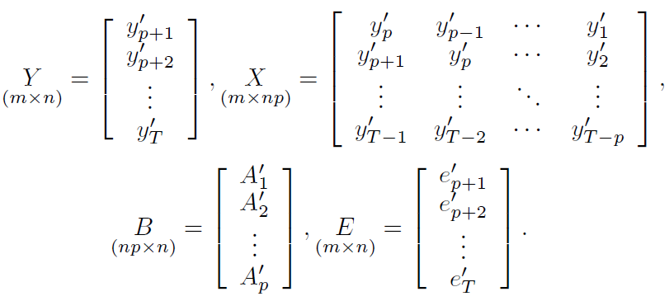
Multivariate Granger Causality model (CGC)
y_{t} is a nx1 vector, representing the expression of n genes at time t.
A_{i} is a nxn matrix, representing the causality at model order i.
OLS solution
Matrix form:
X’X must be invertible
T>=(n+1)p
Notes:
This is by ordinary least square fit.
To make it invertible, we could have different ways to do so.
Regularization to make it invertible: through ridge or lasso, we lose statistical meanings.(Also results are not stable)

Slide 9
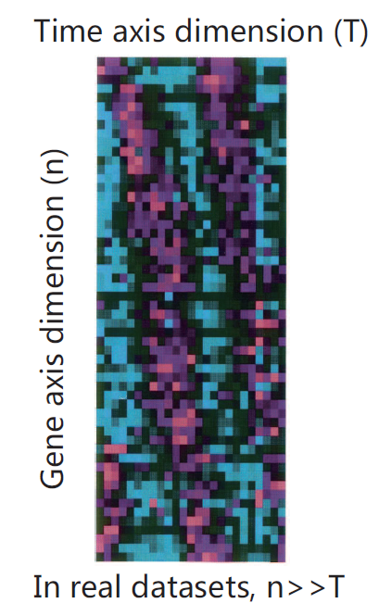
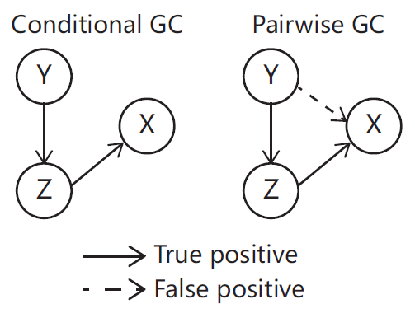
Real situation for CGC and PGC
Limitation of Pairwise GC
Limitation of Conditional GC
Significant number of false positives as n increases
X’X is not invertible
Notes:
When the number of genes n is large, the problem become even more serious: since there are more possible pairs existing.
As n increases,

Slide 10
Overcoming the limitations simultaneously
Limitations in PGC and CGC
False discoveries in PGC.
Lack of data in CGC.
Insufficient information
√
Regularization?
Adding prior info?
Lose F-statistics!
Advantages of using prior knowledge
Different available biological experiment data.
Additional information besides expression data.
Notes:
Especially when number of genes are large, False discoveries become a serious problem.
Biological data properties.
There are other ways to avoid the lack of data problems.

Slide 11
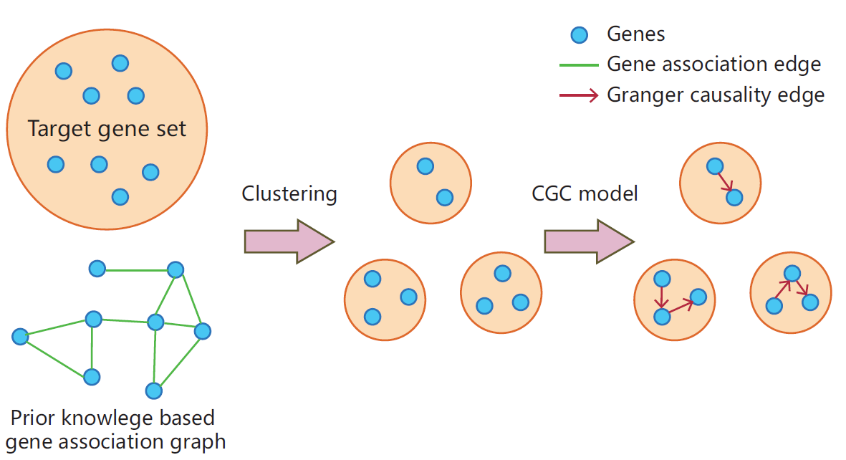
New Framework: Utilizing the prior knowledge
Using prior knowledge to guide clustering to assist Granger Causality analysis

Slide 12
Overview
Motivation
Challenges & Methods
Experiments
Contributions

Slide 13
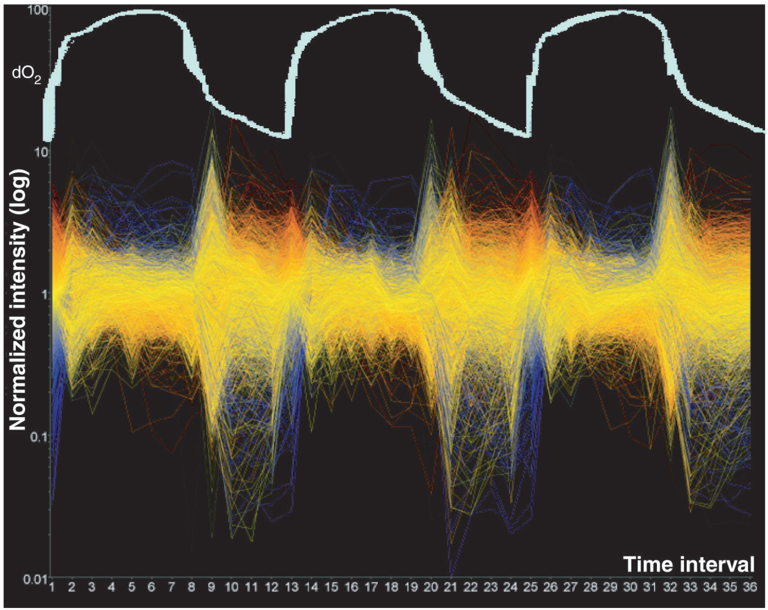
Microarray data: Yeast Metabolic Cycle dataset
Target gene set selection based on significance and periodicity:
2935 genes with 36 times points covering three yeast metabolic cycles
Half of the yeast genome!
The expression profile of 6209 uniquely expressed ORFs
Science 310 (5751), 1152-1158 (2005)
Notes:
Covers around half of the total yeast genes.
Tu. Et al.

Slide 14
Prior knowledge data: YeastNet
A probabilistic functional gene network of yeast genes
Constructed from ~1.8 million experimental observations
Covers 102803 linkages among 5483 yeast proteins
Currently version 2 (version 3 will be available soon)
A general way to summarize heterogeneous knowledge
Graph
Constructing Formula
Where
Plos One 2(10), e988 (2007)
Notes:
More than 95% of the validated proteome of yeast.
Recently there is the version 3 paper.
Score is between zero and 4.5.
We could expect that random pairs or average pairs are WS=0.
Emphasize primary evidence and lower the weight of secondary evidence.
Need more explanation for summarizing hetergeneous knowledge

Slide 15
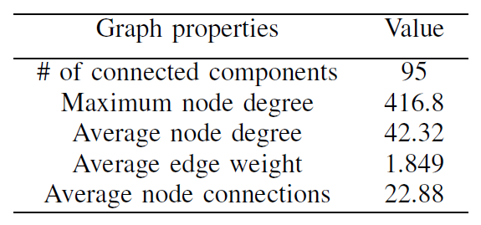
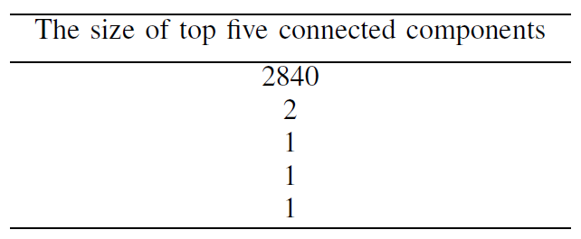
Properties of the extracted YeastNet graph
Extracted YeastNet based on the target gene set
Prior knowledge graph: 2953 nodes and 33583 edges
The nodes are well-connected with each other.
The biggest component covers most of the genes.
The extracted YeastNet is a well-connected gene association graph.

Slide 16
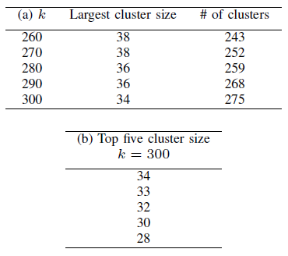
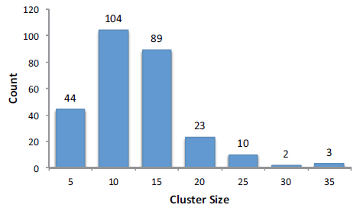
Clustering using prior knowledge graph
We used spectral clustering algorithm to cluster genes
Based on distances/similarities
Normalized cut
The cluster size distribution at k=300
Tuning of the spectral clustering algorithm
Notes:
Compared to Agglomerative clustering strategies, or modularity-based clustering, it could form better small clusters.
In biology, genes tends to form small clusters to achieve certain functions.
We also tried Modularity-based clustering and hierarchical clustering. They tends to form huge clusters (due to the problem of ).

Slide 17
CGC analysis on small clusters
GCCA toolbox developed by Seth.
Model order p is selected by BIC (Bayesian information criterion) criterion.
Bonferroni approach to build Granger causality networks.
Bonferroni approach
For a network with significance level α, the corresponding edge significance level in the graph is α/n(n-1).
Journal of Neuroscience Methods.186:262-273
Notes:
Model order p has significant impact on the final results. However, we plan to investigate the effect of it in the future.
In each small groups.

Slide 18
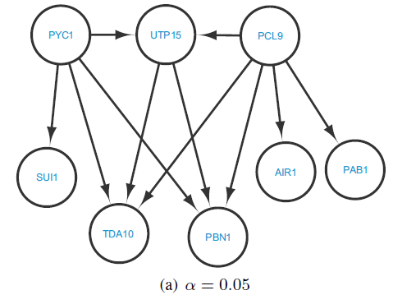
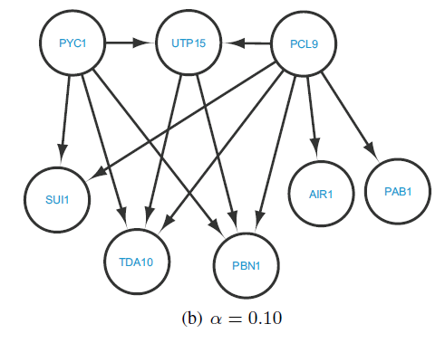
An example discovered network
Edge significance level
0.05/18(18-1)=0.000163
Edge significance level
0.10/18(18-1)=0.000326
Two properties:
1. With different significance value, resulting networks are slightly different.
2. Granger causality networks are highly hierarchical.
Notes:
We could generate different networks based on adjusting the significance value

Slide 19
Functional prediction through the result causality network
Saccharomyces genome database (SGD) function search
PCL9: Cyclin in the late M/early G1 phase.
UTP15, PAB1,PBN1: Cell cycle material preparation genes for early G1 phase.
TDA10: ATP-binding protein with unknown function; similar to an E. coli kinase.
TDA10 might play a signal transduction role in late M/early G1 phase.
Notes:
UTP15: material preparation at nucleus, component of the small subunit (SSU) processome containing the U3 snoRNA that is involved in processing of pre-18S rRNA.
PAB1: Poly A binding protein for RNA processing
TDA10: ATP-binding protein of unknown function. Crystal structure like kinases.

Slide 20
Overview
Motivation
Challenges & Methods
Experiments
Contributions

Slide 21
Contributions
We proposed a new framework on applying Granger Causality analysis to large target gene set to overcome two existing limitations.
PGC limitation: False discoveries
CGC limitation: Lack of data
We used prior knowledge graph to find the group structure inside the target gene set, then applied the more accurate CGC model inside each groups.
Yeast Metabolic cycle dataset are tested as an example. We found meaningful new biological causality networks based on our approach.

Slide 22
Acknowledgements
This work is supported by Brookhaven National Lab LDRD No.13-017.
Questions ?

