Slide 1
Mining Causal Association Rules
Jiuyong Li, Thuc Duy Le, Lin Liu, Jixue Liu, Zhou Jin, and Bingyu Sun
University of South Australia
Adelaide, Australia

Slide 2
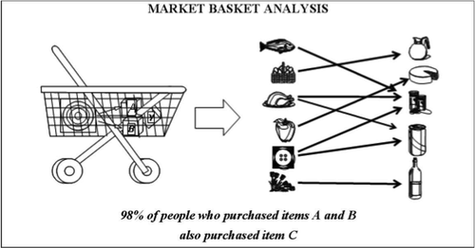
Association analysis
Diapers -> Beer
Bread & Butter -> Milk

Slide 3
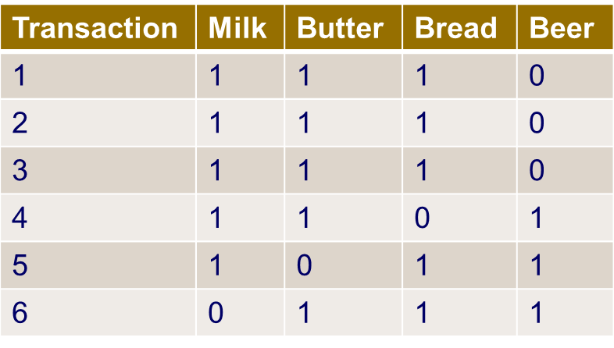
Association rules
Many efficient algorithms
Hundreds of thousands to millions of rules.
Many are spurious.
Interpretability
Association rules do not indicate causal relationships.

Slide 4
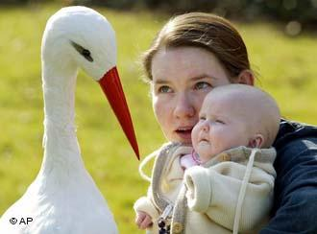
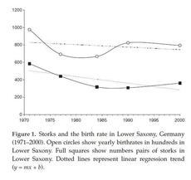
Positive correlation of birth rate to stork population
Increasing the stork population would increase the birth rate?

Slide 5
Further evidence for Causality ≠ Associations Simpson paradox
 | Recovered | Not recovered | Sum | Recover rate
Drug | 20 | 20 | 40 | 50%
No Drug | 16 | 24 | 40 | 40%
 | 36 | 44 | 80
Female | Recovered | Not recovered | Sum | Recover rate
Drug | 2 | 8 | 10 | 20%
No Drug | 9 | 21 | 30 | 30%
 | 11 | 29 | 40
Male | Recovered | Not recovered | Sum | Recover rate
Drug | 18 | 12 | 30 | 60%
No Drug | 7 | 3 | 10 | 70%
 | 25 | 15 | 40

Slide 6
Association and Causal Relationship
Two variables X and Y.
Prob(Y | X) > P(Y), X is associated with Y (association rules)
Prob(Y | do X) ≠ Prob(Y | X)
How does Y vary when X changes?
The key, How to estimate Prob(Y | do X)?
In association analysis, the relationship of X and Y is analysed in isolation.
However, the causal relationship between X and Y is affected by other variables.

Slide 7
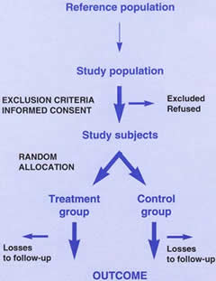
Randomised controlled trials
Gold standard
Expensive
Unethical
Infeasible

Slide 8
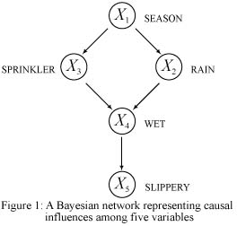
Bayesian network based causal inference
Do-calculus (Pearl 2000)
IDA (Maathuis et al. 2009)
Many others.
However
Constructing a Bayesian network is NP hard
Low scalability to large number of variables

Slide 9
Learning causal structures
PC algorithm (Spirtes, Glymour and Scheines)
Not (A ╨ B | Z), there is an edge between A and B.
The search space exponentially increases with the number of variables.
Constraint based search
CCC (G. F. Cooper, 1997)
CCU (C. Silverstein et. al. 2000)
Efficiently removing non-causal relationships.
CCC
B
A
C
A→B→C, A←B→C, C→A→B
CCU
B
A
C
A→B←C

Slide 10
Cohort study 1
Defined population
Expose
Not expose
Have
a disease
Not have
a disease
Have a
disease
Not have
a disease
Prospective: follow up.
Retrospective: look back. Historic study.

Slide 11
Cohort study 2
Cohorts: share common characteristics but exposed or not exposed.
Determine how the exposure causes an outcome.
Measure: odds ratio = (a/b) / (c/d)
 | Diseased | Healthy
Exposed | a | b
Not exposed | c | d

Slide 12
Characterising cohort study and association rule mining
 | Cohort Study | Association rule mining
A known hypothesis | Yes | No
Human intervention | Yes | Limited
Causal indication | Yes | No
Batch process | No | Yes

Slide 13
Combing cohort study with association rule mining
We can explore causal relationships in large data sets
Given a data set without any hypotheses.
Automatically find and validate causal hypotheses.
Scalable with data size and dimension (with single variables. )

Slide 14
Problem
Discover causal rules from large databases of binary variables
A | B | C | D | E | F | Y | #repeats
1 | 1 | 1 | 1 | 1 | 1 | 1 | 14
1 | 0 | 1 | 1 | 1 | 1 | 1 | 8
1 | 1 | 0 | 1 | 0 | 1 | 1 | 15
0 | 1 | 1 | 1 | 1 | 1 | 1 | 8
0 | 1 | 0 | 0 | 0 | 0 | 0 | 5
0 | 0 | 0 | 0 | 1 | 0 | 1 | 6
1 | 0 | 0 | 0 | 0 | 1 | 0 | 4
1 | 0 | 1 | 1 | 1 | 0 | 0 | 3
0 | 1 | 0 | 1 | 1 | 0 | 0 | 3
0 | 1 | 0 | 0 | 1 | 0 | 0 | 5
A → Y
C → Y
BF → Y
DE → Y

Slide 15
Control variables
Cause
Outcome
Other factors
If we do not control covariates (especially those correlated to the outcome), we could not determine the true cause.
Too many control variables result too few matched cases in data.
How many people with the same race, gender, blood type, hair colour, eye colour, education level, ….
Irrelevant variables should not be controlled.
Eye colour may not relevant to a study of genders and salary.

Slide 16
Method 1
Discover causal association rules from large databases of binary variables
A → Y
A | B | C | D | E | F | Y
1 | 1 | 1 | 1 | 1 | 1 | 1
1 | 0 | 1 | 1 | 1 | 1 | 1
1 | 1 | 0 | 1 | 0 | 1 | 1
0 | 1 | 1 | 1 | 1 | 1 | 1
0 | 1 | 0 | 0 | 0 | 0 | 0
0 | 0 | 0 | 0 | 1 | 0 | 1
1 | 0 | 0 | 0 | 0 | 1 | 0
1 | 0 | 1 | 1 | 1 | 0 | 0
0 | 1 | 0 | 1 | 1 | 0 | 0
0 | 1 | 0 | 0 | 1 | 0 | 0
A | B | C | D | E | F | Y
1 | 1 | 1 | 1 | 1 | 1 | 1
1 | 0 | 1 | 0 | 1 | 1 | 1
1 | 1 | 0 | 1 | 0 | 1 | 0
1 | 0 | 1 | 0 | 1 | 0 | 0
0 | 1 | 1 | 1 | 1 | 1 | 0
0 | 0 | 1 | 0 | 1 | 1 | 0
0 | 1 | 0 | 1 | 0 | 1 | 1
0 | 0 | 1 | 0 | 1 | 0 | 1
Fair dataset

Slide 17
Method 2
A: Exposure variable
{B,C,D,E,F}: controlled variable set.
Rows with the same color for the controlled variable set are called matched record pairs.
Fair dataset
A | B | C | D | E | F | Y
1 | 1 | 1 | 1 | 1 | 1 | 1
1 | 0 | 1 | 0 | 1 | 1 | 1
1 | 1 | 0 | 1 | 0 | 1 | 0
1 | 0 | 1 | 0 | 1 | 0 | 0
0 | 1 | 1 | 1 | 1 | 1 | 0
0 | 0 | 1 | 0 | 1 | 1 | 0
0 | 1 | 0 | 1 | 0 | 1 | 1
0 | 0 | 1 | 0 | 1 | 0 | 1
 | A=0
A=1 | Y=1 | Y=0
Y=1 | n₁₁ | n₁₂
Y=0 | n₂₁ | n₂₂
An association rule is a causal association rule if:
A → Y

Slide 18
Matching
Exact matching
Exact matches on all covariates. Infeasible.
Limited exact matching
Exact match on a few key covariates.
Nearest neighbour matching
Find the closest neighbours

Slide 19
Algorithm
x
x
A | B | C | D | E | Y
1 | 1 | 1 | 1 | 1 | 1
… | … |  |  |  | …
0 | 1 | 1 | 1 | 1 | 0
… |  |  |  |  | …
A | B | C | D | E | F | G | Y
1 | 1 | 1 | 1 | 1 | 1 | 0 | 1
… | … |  |  |  |  |  | …
1 | 1 | 0 | 1 | 0 | 1 | 0 | 1
Remove irrelevant variables (support, local support, association)
For each association rule (e. g. )
A → Y
Find the exclusive variables of the exposure variable (support, association), i.e. G, F.
The controlled variable set = {B, C, D, E}.
3. Find the fair dataset. Search for all matched record pairs
4. Calculate the odds-ratio to identify if the testing rule is causal
5. Repeat 2-4 for each variable which is the combination of variables. Only consider combination of non-causal factors.

Slide 20
Experimental evaluations 1

Slide 21
Experimental evaluations 2

Slide 22
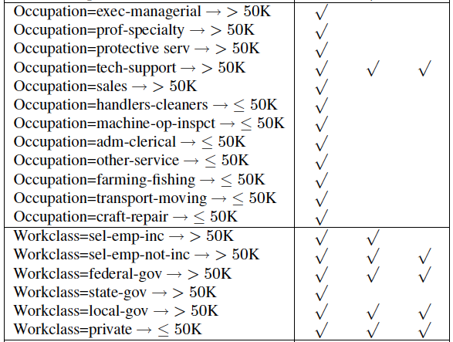
Experimental evaluations 3
CAR CCC CCU
Figure 1: Extraction Time Comparison (20K Records)

Slide 23
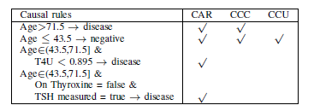
Experimental evaluations 4

Slide 24
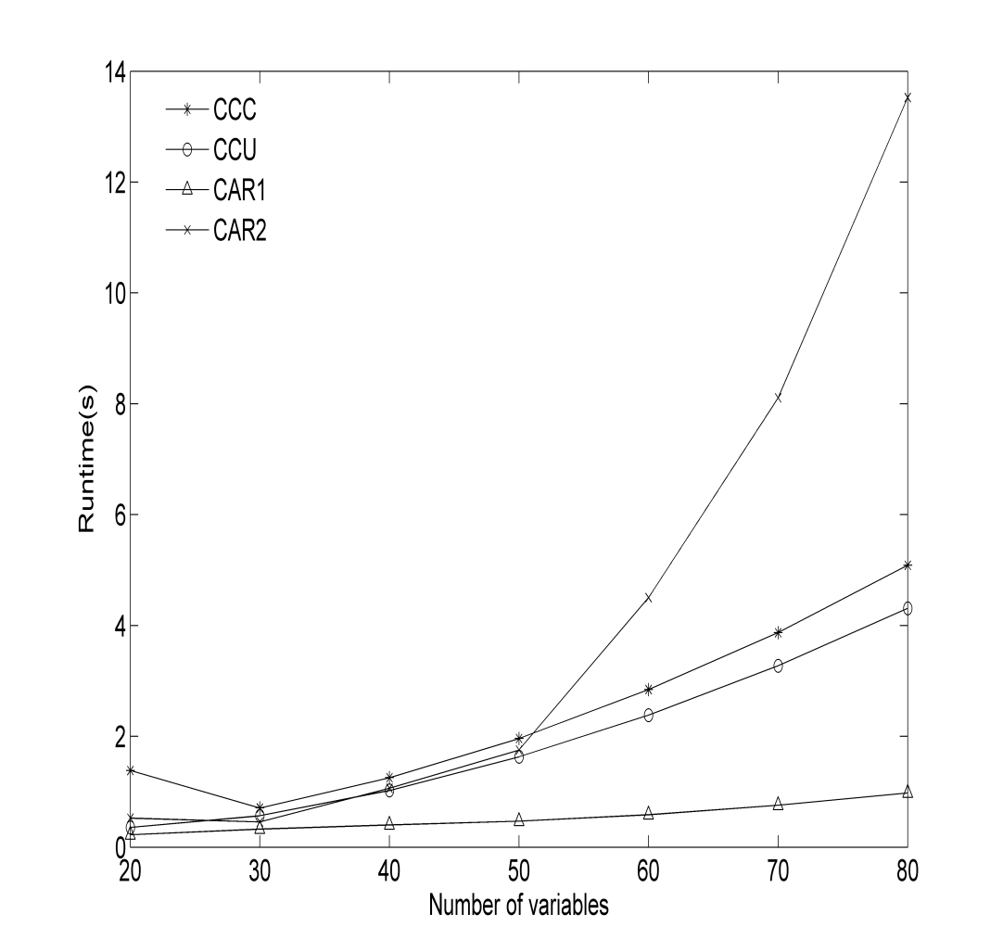
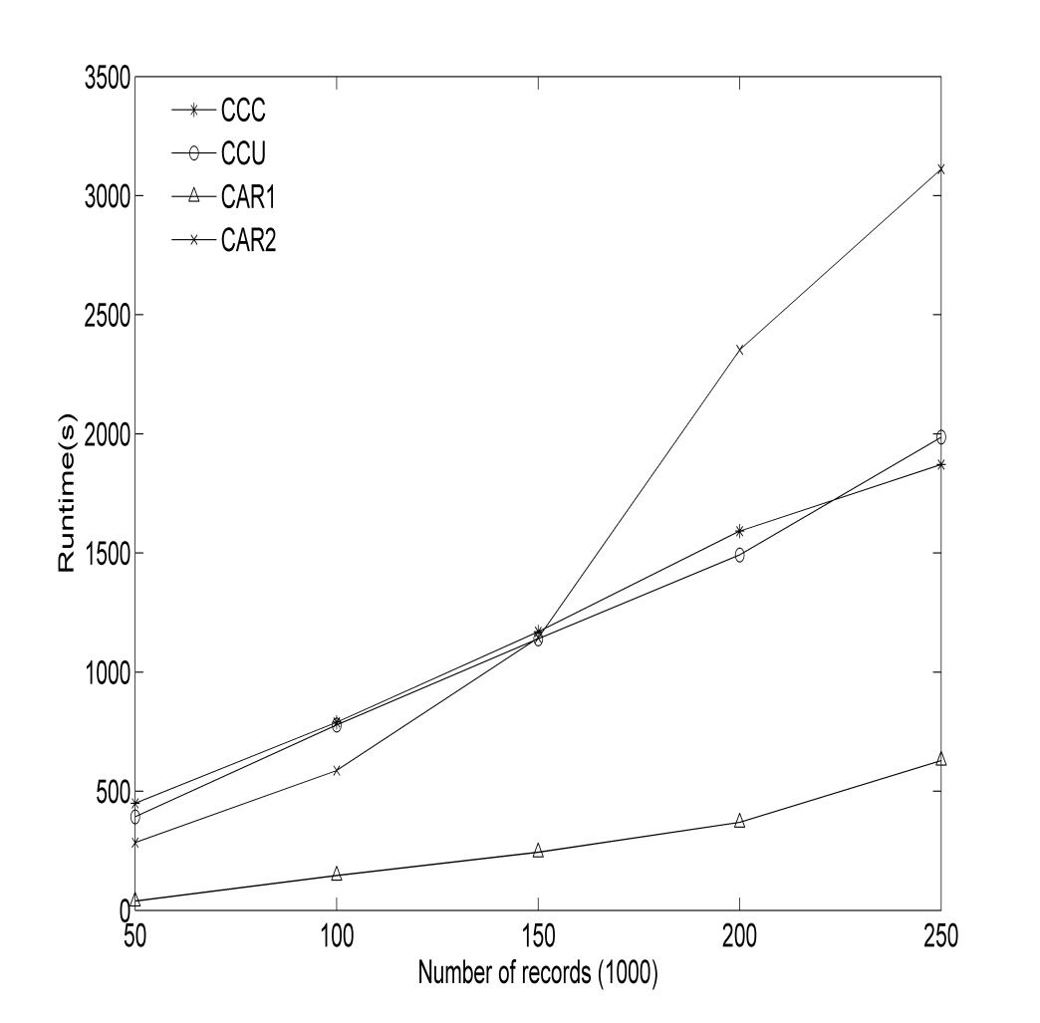
Experimental evaluations 5

Slide 25
Conclusions
Association analysis has been widely used in data mining, but associations do not indicate causal relationships.
Association rule mining can be adapted for causal relationship discovery by combining it with the cohort study
It is an efficient alternative to causal Bayesian network based methods.
It is capable of finding combined causal factors.

Slide 26
Thank you for listening
Questions please ??

