Slide 1
Discovering Causes
Clark Glymour
Carnegie Mellon
With
David Danks, Joseph Ramsey, Richard Scheines and Peter Spirtes

Slide 2
Definitions of “Cause”
“An object precedent and contiguous to another, and so united with it, that the idea of the one determined the mind to form the idea of the other, and the impression of the one to form a more lively idea of the other.”
--David Hume
“We may define a cause to be an object followed by another, and where all the objects, similar to the first, are followed by objects similar to the second. Or, in other words, where, if the first object had not been, the second never had existed.”
--David Hume
“…nothing but correlation”
-- Karl Pearson

Slide 3
Why Cause Is Not Correlation
A B
Sample
A B A B
U
A B Etc.
A and B will be correlated in the sample
A B
A, B are independent in probability in each sub-population, but dependent in the combined population (Yule, 1904)
A B
A and B share a common cause

Slide 4
Exploiting Hume’s 2nd Definition
Causal claims are about changes of distributions of some variables (effects) upon hypothetical interventions upon others (causes).
The claim that A causes B implies that if the distribution of values of A were (exogenously!) varied, then the distribution of values of B would vary, ceteris paribus.
Note the circularity
Note the vagueness

Slide 5
Old Idea (Wright, 1921)
Represent variables as vertices in a directed graph.
Represent “direct” (relative to the set of vertices) causal relations between variables by directed edges in the graph.
What should be the relation between graphical structure and joint probability distributions on the variables?

Slide 6
Proposal: The Causal Markov Condition (T. Speed, 1981)
In a directed acyclic graphical representation of causal connections among a set S of variables, any variable, X, in S is independent of the set of all variables in S that are not effects of X, conditional on values of the direct causes of X.
N.B. Two variables are independent if and only if each value of either is independent of each value of the other.
A B D C
E F A, E || D | B,F

Slide 7
Markov Factorization
If P is a joint distribution of the variables in a directed acyclic graph (DAG) G and is Markov for G, then the probability of any assignment of values for the variables is the product of the probability of the value of each variable conditional on the values of its parents in G.
X P(X,Y,Z,W) = P(W|Y)P(Y|X,Z)P(X)P(Z)
Y W Markov Equivalence = Same
Z factorization

Slide 8
The Causal Connection: The Manipulation Theorem (Spirtes, et al. 1993)
Suppose the hypothesis
Y
X Z W P(W,Z,X,Y) = P(W|Z)P(Z|X,Y)P(X|Y)P(Y)
What joint distribution is predicted if X is forced to have a new distribution, P*(X)?
Y
X Z W P*(W,Z,X,Y) = P(W|Z)P(Z|X,Y) P*(X)P(Y)

Slide 9
Upshot
Under the Markov Condition, a causal DAG specifies a set of conditional independence constraints on any joint distribution of the variables, and sets of (counterfactual, or predicted) conditional independence relations under various “surgical” interventions.
Can be generalized to interventions that are “soft”—that alter but do not eliminate the dependence of a manipulated variable on other variables in the graph.

Slide 10
Technicalia
There are fast, purely graphical conditions (Pearl,1987, Lauritzen) for determining conditional independence relations implied by the Markov Condition applied to a DAG.
The Markov Condition does not hold for cyclic graphs.
But the purely graphical conditions generalize and hold for linear cyclic systems. (Spirtes, 1994)

Slide 11
From Graphs to Statistical Models: Parameterization
Pseudo-indeterministic:
Z Y = f(X,Z) + eY Distributions of noise and exogenous variables.
X Y
Any deterministic Unmeasured sources of
linking function, f variation in Y (additive noise)
Multinomial, categorical:
P(X = 1), P(X = 1)
P(Y = 1| X = 1, Z =1)
P(Y = 1| X = 1, Z =0) Multinomial, categorical
P(Y = 1| X = 0, Z =1)
P(Y = 1| X = 0, Z =0)
Time series: Just index the variables by time.

Slide 12
Search = Estimation
H: Space of Alternative Causal Hypotheses
Space of Alternative Parameterizations
Sampling Regime
Search method: a function from samples to subsets of H—i.e. a point or set valued estimator.

Slide 13
What Should An Estimator Do?
Have useful sufficient conditions for convergence to correct information in the large sample limit (Consistency)
Pointwise
Uniform
Be unbiased
Short run
Asymptotically
Be robust against violations of sufficient conditions for consistency
Be fast
Give the right answers in practice.

Slide 14
An Underdetermined Problem
We need further assumptions!
Linearity + non-Gaussianity, or
Faithfulness (all conditional independence relations are consequences of the Markov Condition for the true causal graph), or
Adjacency Faithfulness (two variables are directly connected by an edge only if no conditioning set makes them independent), or
???

Slide 15
A Quarter Century Research Strategy
Start with a bounded problem:
acyclic causal structure
no unobserved common causes
i.i.d. Normal or Multinomial data
estimate Markov equivalence classes of graphs
Find a consistent, feasible estimator (algorithm)
Investigate:
Complexity
` Finite sample performance
Repeat with harder problems: generalize; specialize.
Scale up.

Slide 16
Strategies
Estimate undirected Estimate jointly:
skeleton and directions
separately:
All methods that use ICA methods
conditional independence Bayesian methods
tests

Slide 17
Solved (?) Problems
I.i.d. Normal or Multinomial data; no unobserved confounders; acyclic; no sample selection bias:
PC (1991); GES (1996); many others
I.i.d. Normal, Multinomial data; unobserved confounders; acyclic; sample selection bias:
FCI (1993); RFCI (2012)
I.i.d. Linear systems, no unobserved confounders; no sample selection bias:
CCD (1996)

Slide 18
Solved (?) Problems
Discovering the Unobserved (Silva, 2006):
Data U1 U2 U2
X1, X2, X3, ….Xmany X1 X4 X8 X11 X13 X16 X20 X21 X22
Generalized to non-linear systems (Spirtes, 2013).
Partial sound replacement for factor analysis.

Slide 19
Solved (?) Problems
Multiple, non-i.d. data sets (Tillman, 2009; Ramsey 2013) :
X Y Z
Learning graphical causal structure from a mixed data set (Meek, ?)

Slide 20
Solved Problems
Identify causal systems with feedback and latent variable confounding, provided:
An oracle for conditional independence
Experimental interventions. (Hytinnen, 2013; Tsamarindos)
Uses Satisfiability algorithms. Limited to about 12 variables.

Slide 21
Unifications of fragmentary models with overlapping variable sets ( Danks, 2005; Tillman)
Truth:
X U R Z and W are not measured together
Z W U is not measured at all.
Y Q
Measure X,Y,R,Q,W Measure X,Y,Z,Q,R
X R X R
W Z
Y Q Y Q

Slide 22
Trade-Offs
Fewer constraints on search space =>
more complex search, less information recovered
E.g.
PC, GES return Markov Equivalence class of observed variables
FCI returns all DAGs Markov Equivalent over the observed variables.
LiNGAM returns unique causal graph of observed variables

Slide 23
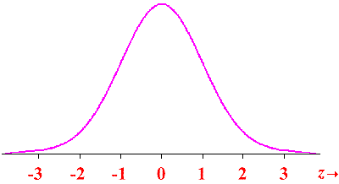
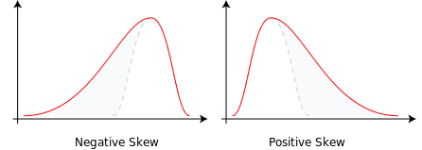
Generalizing Conditional Independence Tests Beyond the Normal
I.i.d data:
Tillman, 2009
Zhang, 2011
Harris & Drton , 2012
Ramsey, 2013

Slide 24
Some UnSolved Problems
Non-stationary time series
Time series with unknown sampling rates (Danks and Pils, NIPS)
Non-linear feedback
Feedback and/or sampling bias with Latent Variables
Endogenous latent variables
Identifying multiple latent common causes and their causal relations (Spirtes)
All sorts of other stuff I haven’t thought of.

Slide 25
Scaling Up
For high dimensional systems with complex causal connections (e.g., brain imaging)
Bayesian methods do not scale up
Constraint based methods scale up, but estimates of directions of influence become unreliable
Solution (?): Estimate causal skeleton with PC or somesuch; estimate causal directions from joint distribution of directly connected pairs of variables.

Slide 26
Bivariate Orientation Methods
Gaussian, i.i.d. additive noises (Janzing? 2012?)
Non-linear, Gaussian noises (Hoyer, 2009)
Linear, non-Gaussian additive noises (Hyvarinen and Smith, 2013)
Non-linear, non-Gaussian inner additive noises (Zhang and Hyvarinen, 2008)

Slide 27
The (A!)Trouble with PC
Truth: X Y Z
PC 1: X Y Z Z = aY + e_{z}
Y = bX + e_{y}
Standardized: ρ_{yz} = a; ρ_{xy} = b; ρ_{xz} = ab.
PC 2: X Y Z iff X II Z iff ab is too small
Result: In chains of causes, PC tends to overestimate “colliding” arrows. General problem for “contracting” linking functions.

Slide 28
Applications
College Dropouts
Acid Rain
Gene Regulation
Brain Imaging
Climate Dynamics
Psychometrics
Leaf ecology
OnBoard Satellite Instrument Recalibration

Slide 29
College Dropouts
Data from 1993-94 U.S. News and World Report surveys.
PC analysis says
1994 CMU alters financial aid policies to increase average SAT scores of freshman class
Dropout rate from 1994 on decreases monotonically with increasing average SAT of freshman class
Everything else Average SAT Dropout rate

Slide 30
Spartina in the Cape Fear Estuary

Slide 31
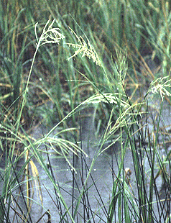
What Factors Directly Influence Spartina Growth in the Cape Fear Estuary?
pH, salinity, sodium, phosphorus, magnesium, ammonia, zinc, potassium…, what?
14 variables for 45 samples of Spartina from Cape Fear Estuary.
Biologist concluded salinity must be a factor.
PC net analysis says only pH directly affects Spartina biomass for the range of observed variables

Slide 32
Acid Rain
Linthurst collected 45 plugs of Spartina grass from the Cape Fear Estuary and measured 14 variables including biomass.
PC concludes only variable that directly influences biomass in pH
Linthurst, convinced that salinity has a direct effect, did a randomized greenhouse experiment.
Results:
pH influences biomass when salinity is held constant;
salinity has no influence on biomass if pH is held constant.

Slide 33
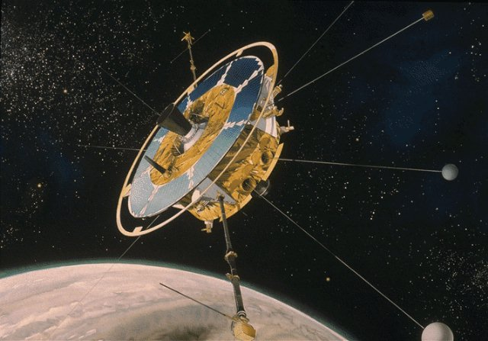
The Swedish Freja Satellite

Slide 34
Miscalibrations
Miscalibrated mass spectrometer designed to detect ion bursts.
Bayes net procedures used to identify the errors
Recalibration reduces estimated errors by half.
Light ions Heavy ions

Slide 35
The Influence of Lead Exposure on Children’s IQ
Needleman: ANOVA, many variables, small negative effect of lead exposure
NIH statisticians: Needleman must redo with stepwise regression
Needleman: Stepwise regression, 6 significant regressors, small (but bigger) effect of lead exposure
CMU econometricians: Measurement error—influence of lead exposure cannot be bounded away from zero.

Slide 36
Influence of Low Level Lead Exposure on Children’s IQ
Scheines: PC; 3 of the 5 covariates have NO correlation with IQ.
Scheines: CMU econometricians must give their prior distribution for measurement error.
Scheines: Bayesian estimation (with Gibbs' sampling for posterior distribution) of effect of low level lead exposure on IQ using;
PC selected variables
Econometricians’ measurement error model
Econometricians’ priors for variances

Slide 37
The CMU Economists’ Model with TETRAD Covariates

Slide 38
Result: Lead is Twice as Bad as Needleman Thought

Slide 39
And the Elimination of Causally Irrelevant Variables Is Critical

Slide 40
Mass Cytometry Protemics(Tsamarindos)
Activator
Protein1
Protein2
Activator
Protein1
Protein3
Protein2
OR
Activator
Protein3
Protein2
Activator
Protein3
Protein1
Protein2
Check whether predicted triplet has also been reported
42% of the predicted triplets are also reported
Despite strict thresholds and multiple testing
Theory+algorithms: [Tillman et. al. 2008, Triantafillou et. al 2010, Tsamardinos et. al 2012]

Slide 41
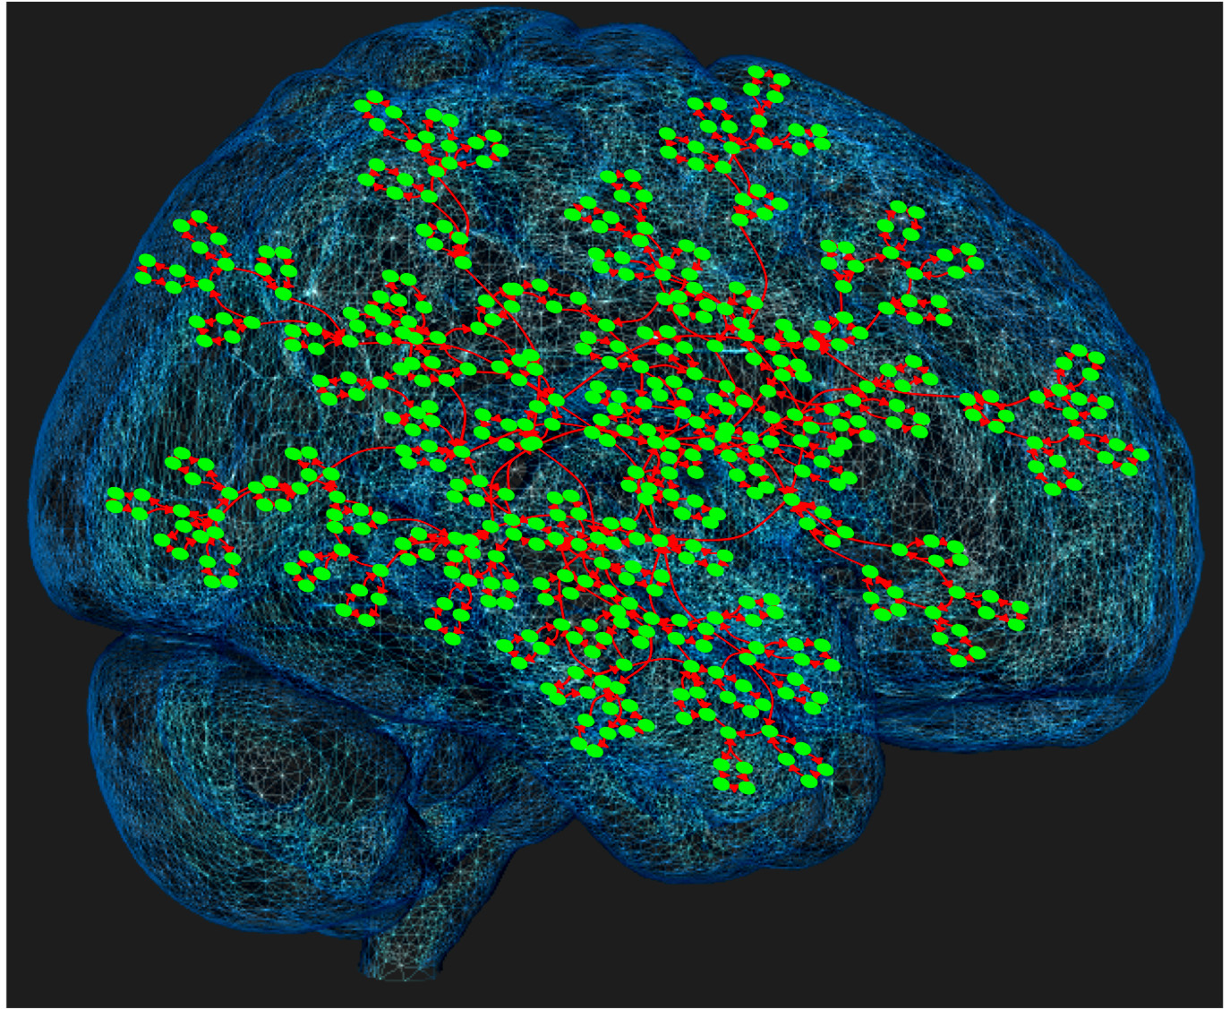
fMRI (Ramsey, 2013)

