Slide 1
Advances in Causal-Based Feature Selection
Ioannis Tsamardinos and Giorgos Borboudakis
Associate Prof. Computer Science Department, University of Crete
CEO and co-founder, Gnosis Data Analysis PC
Visiting Professor, University of Huddersfield
work performed by the Mens Ex Machina group www.mensxmachina.org
Slides help: Kleanthi Lakiotaki, Sofia Triantafillou, Vincenzo Lagani

Slide 2
Messages
Feature Selection is arguably the main tool for knowledge discovery
Causal models help understand the feature selection problem, in a non-parametric way
Causally-inspired algorithms
Provide theoretical guarantees
Applicable to any type of data for which a conditional independence test is available
Scale up to tens of millions of features and tens of millions of rows (Big Volume Data)
Competitive predictive performance against alternatives (e.g., Lasso)
Can find multiple, statistically-equivalent solutions
Solution(s) has intuitive causal interpretation
Robust, efficient implementations available

Slide 3
Outline / Structure
The feature selection problem
Why feature selection
Conditional Independence / Dependence
Defining the feature selection problem
The Markov Blanket
The Markov Blanket as the solution(s) of the feature selection problem
Causality and feature selection
Causal models
Causal models and entailed Independencies: d-separation
Faithfulness
The Markov Blanket in causal models with and without latents
Algorithms
Single Solution algorithms
Algorithm: basic forward-backward
Algorithm: forward-backward with pruning
Algorithm: MMPC, HITON, symmetric MMPC
Algorithm: MMMB
Multiple, statistically-equivalent solutions
Algorithm: TIE*
Algorithm: SES
Algorithm: multiple FB
Big Volume Data algorithms
Parallel FB
Parallel Univariate Association
SFO
PFBP
The MXM package
A qualitative comparison with the Lasso
Conclusions
Acknowledgements

Slide 4
The feature selection problem

Slide 5
Why feature selection
Training data
Model
predictors
Learning Method
x6
ID | x₁ | x₂ | x₃ | x₄ | …. | x_{m} | target
1 | 26 | 0 | 0.3 | 0.06 | … | 2 | yes
2 | 52 | 1 | 2.3 | 0.1 | … | 2 | no
… | … | … | … | … | … | …
n | 34 | 0 | 5.8 | 0.04 | … | 3 | no
f
x4
x8
x5
x84
x3
x9
instances
x32
x64
x87
x41
x22
x33
x24
x38
y
n
y
n
y
n
y
n
y
n
y
n
y
n
y
n
Training data
predictors
Feature selection
Model
Learning
Method
ID | x₁ | x₂ | x₃ | x₄ | …. | x_{m} | target
1 | 26 | 0 | 0.3 | 0.06 | … | 2 | yes
2 | 52 | 1 | 2.3 | 0.1 | … | 2 | no
… | … | … | … | … | … | …
n | 34 | 0 | 5.8 | 0.04 | … | 3 | no
ID | x₃ | x₄ | x_{m} | target
1 | 0.3 | 0.06 | 2 | yes
2 | 2.3 | 0.1 | 2 | no
… | … | … | …
n | 5.8 | 0.04 | 3 | no
Selection
f
x4
instances
x59
x54
y
n
y
n

Slide 6
Why Feature Selection?
Feature selection is the main tool for knowledge discovery with data analysis
Often it the primary goal of the analysis; the predictive model is only a side-product
Provides intuition to “what matters” for prediction
Connected to the causal mechanisms generating the data (Pearl, 1988)
Dimensionality Reduction, e.g., PCA, is harder to interpret
Feature Selection = Knowledge Discovery
Also, may actually improve predictive performance
By removing irrelevant or redundant features, learning algorithms are facilitated
Reduces the cost of storing, computing, measuring, processing the data

Slide 7
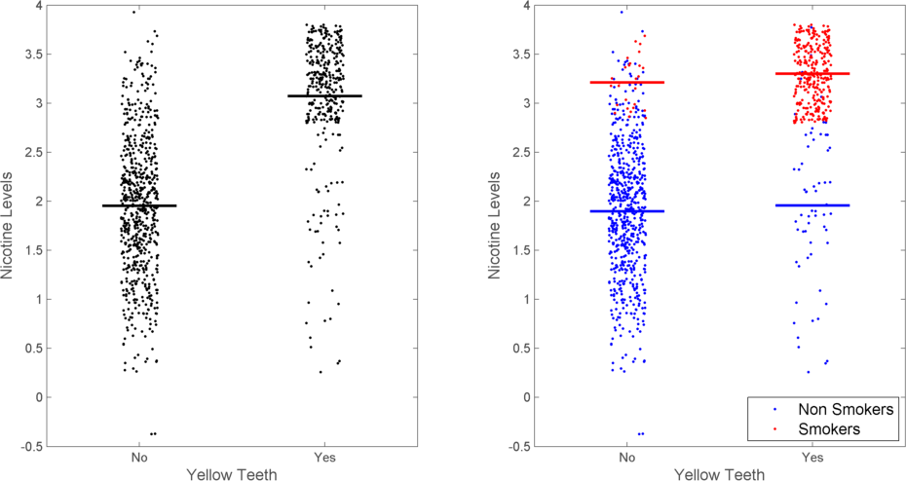
Independence and Conditional independence
Data measuring: Smoking
Yellow Teeth
Nicotine Levels
P(Nicotine Levels | Smoking, Yellow Teeth) = P(Nicotine Levels | Smoking)
Notation: Ind(NL ; YT | S)
Two (unconditionally) dependent quantities that become conditionally independent

Slide 8
Conditional Dependence
Y
Y
X
X
P(Color|X ) ≠ P(Color|X, Y)
Notation: Dep(C; Y|X)
Two (unconditionally) independent quantities that become conditionally dependent

Slide 9
Conditional (In)dependence in General
The concept extends to
Continuous quantities (linear and non-linear types of dependence / correlation)
Continuous vs. discrete quantities
Time-to-event quantities (survival analysis)
Time-course data (a gene expression’s trajectory providing information for another gene expression’s trajectory)
We employ statistical tests to determine conditional independencies with finite sample
Only access to the data through conditional independence tests
Statistical tests return a p-value:
Small p-value ⇒ (highly likely) dependence
Large p-value ⇒ independence (actually “I don’t know”)
Conditioning on large sets makes p-values unreliable (loses statistical power)

Slide 10
Defining Feature Selection (Oracle)
Single Solution: Find a minimal-size feature subset S⊆ F, s.t. Ind(T ; F\{S}| S)
Equivalently: P(T | S) = P(T | F)
Selected features S do not change the conditional probability of T
Selected features S carry all information to predict/diagnose T
There is no subset S′ ⊆ S s.t. P(T | S′) = P(T | S)
Definition requires knowledge of P(T | F)
S : a minimal-size set that renders all other features conditionally independent of T
S is called a Markov Blanket of T (Pearl, 1988)
NP-complete problem even for linear regression (Welch,1982)

Slide 11
Defining Feature Selection: Subtleties
Implications of “Minimal-size”: encoding of observed quantities as features matters
Assume {X, Y} a solution, L not in solution
Create Cartesian product Z = X × Y × L
Z becomes a solution even though {X, Y, L} is not
How observed quantities are encoded as features affects solutions!
Implications of “minimal” vs. “minimum”
Assume solution |S₁| = 1, S₁ discrete, S₂ = distributed encoding of S₁
“minimal” in the definition: both S₁ and S₂ are solutions
“minimum” in the definition: only S₁ is a solution

Slide 12
Defining Feature Selection (no oracle)
Single Solution:
Maximize performance of model built with features S using learner f, s.t. |S| is minimal
No knowledge of conditional distribution of T, need to estimate from finite sample

Slide 13
Defining Feature Selection: Subtleties
“Maximizing performance”: solution depends on performance metric
Example, P(T+ | X+) = 0.6, P(T+ | X-) = 0.7. and metric is accuracy: accuracy is maximized without X!
“using learner f”: solution depends on learner
Example by (Kohavi & John, 1997)
T = X + constant + ε, ε~N(0,1), Y = 1 always, and learner f is a linear classifier without a constant term
Optimal model fit with f as T = X + constant ×Y, Y participates in the solution!
Sufficient conditions for finite-sample solution to converge to the asymptotic one
Learner should converge to (learn) P(T | S) for a solution S
Performance metric (loss) is optimized asymptotically only when Ind(T ; F\{S}| S)

Slide 14
Multiple Feature Selection
Important problem!
Knowledge discovery: Misleading to inform a biologist that only genes in S are “important” when other genes S′ could replace them!
Cost-aware feature selection: when features have measurement cost, give options what to measure
Multiple Solutions: Find all minimal-size subsets, s.t. S⊆ F, s.t. Ind(T ; F\{S}| S)
Not all minimal-size subsets have to have the same size!
Much less studied problem
See KIAMB (Peña et al., 2007), TIE* (Statnikov et al., 2013), SES (Tsamardinos et al., 2012) & (Lagani et al., 2017) for current approaches
Related to stability of solutions!
With finite sample, find all solutions that are “statistically indistinguishable”
Possible definitions of indistinguishable feature subsets S₁ and S₂
Performance Equivalence: performance metrics on predictions are the same (in a statistical sense) given the learning method
Model Equivalence: conditional distribution of predictions is the same given the learning method (independent of performance metric)
Information Equivalence: conditional distribution of predictions is the same (independently of performance metric and learner)

Slide 15
A Classification of Feature Types
X provides no information for T in all contexts:
If Ind(X ; T | Z), ∀Z ⊆ F
Then X is irrelevant
X in all solutions (Markov Blankets)
If ∀S ⊆ F s.t., S minimal, Ind(F\S ; T | S), then X ⊆ S
Then X indispensable
X not indispensable, but X in some solutions
The information provided by X is necessary for optimal prediction, yet, it can be substituted with other features
X replaceable
Replaceable features will not be stable!
X not irrelevant, or indispensable, or replaceable
X provides information for predicting T in some context (conditioned on some Z ⊆ F), but not required
Then X is redundant
Older classification to irrelevant, weakly relevant, strongly relevant (Kohavi & John, 1997) coincides with irrelevant, redundant, indispensable when solution is unique

Slide 16
Causal models

Slide 17
Bayesian Networks (BNs)
JPD($V$): P
Directed Acyclic Graph G
Smoking
 |  | CVD
Yellow Teeth | Smoking | Y | N
Y | Y | 0.17 | 0.06 | 0.13
N | Y | 0.06 | 0.02 | 0.08
Y | N | 0.02 | 0.06 | 0.08
N | N | 0.15 | 0.46 | 0.61
 |  | 0.4 | 0.6 | 1
What connects the two?
Yellow Teeth
CVD
(Causal) Markov Condition (MC):
Every variable is independent of its non-descendants given its parents
Causal interpretation: substitute “direct cause” for “parent” and “non-effect” for “non-descendant”
Notes:
Causal Bayesian Networks: A Graph and a probability distribution

Slide 18
Factorization with the MC
P(Smoking, Yellow Teeth, CVD) =
P(Smoking) ×
P(Yellow Teeth | Smoking ) ×
P(CVD | Smoking, Yellow Teeth)
Smoking
Yellow Teeth
CVD

Slide 19
Factorization with the MC
P(Smoking, Yellow Teeth, CVD) =
P(Smoking) ×
P(Yellow Teeth | Smoking ) ×
P(CVD | Smoking, Yellow Teeth)
Smoking
Yellow Teeth
CVD
Dropped because of the Markov Condition
$$P\left(\text{V}\right)=\prod_{i}{P\left(\left.V_{i}\right|\text{Parents} \text{of} V_{i} \text{in} \text{the} \text{graph}\right)}$$
In general:

Slide 20
ASSUMPTIONS
Markov Condition:
Every variable is independent of its non-descendants given its parents.
X
Y
Z
Faithfulness Assumption:
Independences stem only from the network structure, not the parameterization of the distribution.
$$Ind(Y, Z |X)$$
$$Dep(Y, Z | ∅)$$
$$Dep(X, Z | ∅)$$
$$Dep(X, Z | Y)$$
$$Dep(Y, X | ∅)$$
$$Dep(Y, X | Z)$$
Some independencies are determined explicitly by the MC, some are entailed using probability theory
All independencies in J can be identified in G using the graphical criterion of d-separation.

Slide 21
The d-separation criterion
Algorithm to determine all independencies entailed by the Markov Condition.
Paths in the graph represent information flow (or lack thereof)

Slide 22
Example
P(B)
0.001
P(E)
0.002
Burglar
Earthquake
You have an installed alarm.
Burglars set off the alarm.
Earthquakes set of the alarm.
When the alarm goes off, one of your neighbors (John or Mary) may call you.
B | E | P(A|B, E)
T | T | 0.95
T | F | 0.94
F | T | 0.29
F | F | 0.001
Alarm
A | P(JC|A)
T | 0.7
F | 0.2
A | P(MC | A)
T | 0.85
F | 0.4
John Calls
Mary Calls
Example by J.Pearl

Slide 23
Open Paths
Burglar
Earthquake
A directed path is an open path (it allows information to flow).
Alarm
John Calls
Mary Calls
When your house is being robbed, the probability of getting a phone call from John is higher than usual (due to the alarm going off).
$$\text{D}\text{ep}\text{(}\text{Burglar}\text{ ; }\text{John} \text{Calls}|∅)$$

Slide 24
Blocked Paths
Burglar
Earthquake
Conditioning on intermediate “causes” blocks the path.
Alarm
John Calls
Mary Calls
If you know the alarm has gone off, whether this was due or not to an actual burglary does not change your belief about the probability of getting a phone call from John.
$$\text{I}\text{nd}\text{(}\text{Burglar}\text{ ; }\text{John} \text{Calls}|Alarm)$$

Slide 25
Open Paths
Burglar
Earthquake
A path that goes through a common “cause” is an open path (it allows information to flow).
Alarm
John Calls
Mary Calls
When John calls you, the probability that Mary will also call you is higher than usual (because John usually calls when the alarm has gone off).
$$\text{Dep}\text{(}\text{John} \text{Calls}\text{ ; }\text{Mary} \text{Calls} |∅)$$

Slide 26
Blocked Paths
Burglar
Earthquake
Conditioning on common “causes” blocks the path.
Alarm
John Calls
Mary Calls
$$\text{Ind}\text{(}\text{John} \text{Calls}\text{ ; }\text{Mary} \text{Calls} |Alarm)$$
If you know the alarm has gone off, whether John has called does not change your belief that Mary will call.

Slide 27
Blocked Paths
Burglar
Earthquake
A path that goes through a common “effect” (collider) is a blocked path (no information flows).
Alarm
John Calls
Mary Calls
$\text{Ind}\text{(}\text{Burglar} ; \text{Earthquake}$|$∅$)
Burglaries and earthquakes are not correlated.

Slide 28
Open Paths
Burglar
Earthquake
However, conditioning on common “effects” opens the path (information flows through the path.)
Alarm
John Calls
Mary Calls
$\text{Dep}\text{(}\text{Burglar} ; \text{Earthquake}$|$\text{Alarm}\text{)}$
Your alarm has gone off. If there is also no earthquake, you think there must be a burglary.

Slide 29
Open paths
However, conditioning on common (not necessarily direct) “effects” opens the path (information flows through the path).
Burglar
Earthquake
Alarm
John Calls
Mary Calls
$\text{Dep}\text{(}\text{Burglar} ;\text{Earthquake}$|$\text{Call}\text{)}$
John is calling. If there is no earthquake, you think a burglary is more probable.

Slide 30
The d-separation criterion
Open (d-connecting) paths :
A path is d-connecting given Z iff
every collider on the path is in Z or has a descendant in Z
AND
every non-collider on the path is not in Z.
Otherwise, the path is blocked (d-separating).
The same path can be d-connecting given $Z_{1}$, d-separating given $Z_{2}$

Slide 31
The d-separation criterion
Algorithm to determine all independencies that are entailed by the Markov Condition.
Notation: $dsep\left(\text{A}\text{, }\text{B} | Z\right)$: $A$ and $B$ are d-separated given $Z$.
$dcon\left(\text{A}\text{, }\text{B} | Z\right)$: $A$ and $B$ are d-connected given $Z$.
$dsep\left(\text{A}\text{, }\text{B} | Z\right)$: all paths between A and B in the graph are blocked given Z
$dcon\left(\text{A}\text{, }\text{B} | Z\right)$: at least one path is open
Theorem: Ind( A ; B | Z) if and only if dsep(A, B | Z) (in faithful BNs)

Slide 32
A note on Faithfulness
Sun exposure
Sunscreen
Melanoma
Sunscreen (directly) causally reduces your chances of melanoma
Sunscreen makes people stay longer in the sun, which increases the chances of melanoma
Faithfulness Violation = The parameters are set so associations cancel each other out!

Slide 33
Causality and the feature selection

Slide 34
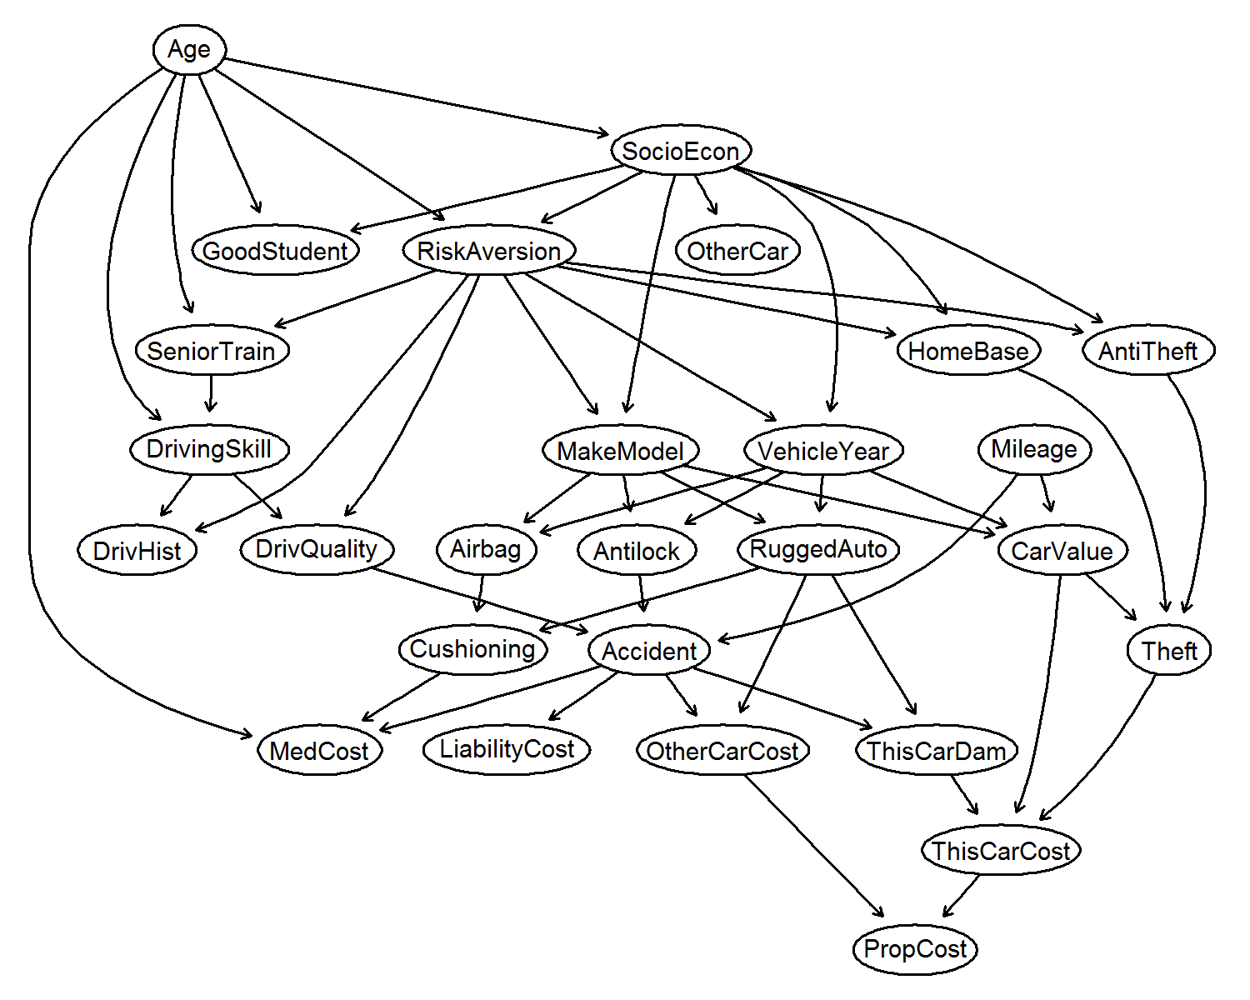
What is the Markov Blanket of `MakeModel`?
Neighbors cannot be d-separated; need to condition upon
But, then spouses become d-connected; need to condition upon
Spouses = nodes with common children
Markov Blanket
Neighbors (parents and children) of T
Spouses of T
:Target
:Neighbors
:Spouses

Slide 35
What is the Markov Blanket of `MakeModel`?
Markov Blanket
Neighbors (parents and children) of T
Spouses of T
Theorem: The Markov Blanket of T is unique in Faithful distributions
In distributions faithful to a Bayesian Network
Markov Blanket = indispensable
Non-Markov Blanket features connected with a path to T are redundant
Features not connected with a path to T are irrelevant
There are no replaceable features
:Target
:Neighbors
:Spouses

Slide 36
What is the Markov Blanket of `MakeModel` with latent variables?
Nodes in boxes not measured
Neighbors cannot be d-separated; need to condition upon
But, then anything on a collider path cannot be d-separated
Collider path = path where all intermediate, observed nodes (if any) are colliders
Markov Blanket
All nodes connected to T with a collider path
:Target
:Neighbors
:other MB members

Slide 37
What is the Markov Blanket of `MakeModel` with latent variables?
Nodes in boxes not measured
Subtleties: paths are to be calculated on the marginal of the Bayesian Network (called a Maximal Ancestral Graph)
Cushioning becomes a Child of T in the marginal network
Needs theory of marginal of Bayesian Networks: Maximal Ancestral Graphs
Markov Blanket
All nodes connected to T with a collider path
:Target
:Neighbors
:other MB members

Slide 38
Feature Selection Intrinsically Related to Causality!
Causalities determine the solution to the feature selection problem
Explains theoretically why Feature Selection is used for Knowledge Discovery
Feature selection becomes a causal discovery problem

Slide 39
Single-solution algorithms

Slide 40
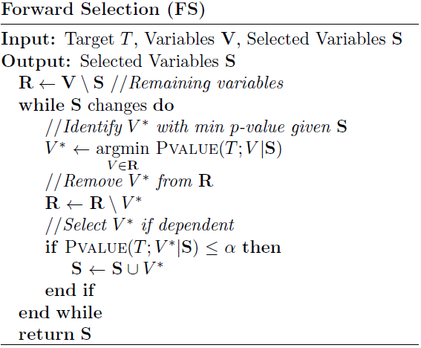
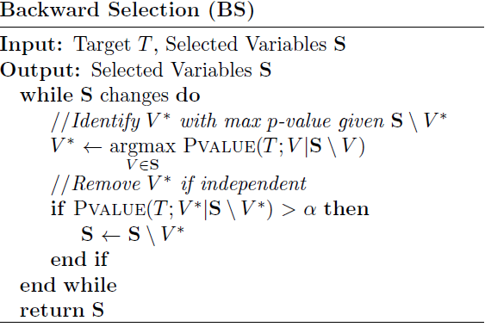
Basic Forward-Backward Search
Need to compute p-values with all other features for each selection
Need to compute p-values with all other selected features
End of forward phase:
False positives: OtherCarCost
:Target
:Selected

Slide 41
Basic Forward-Backward Search
:Target
:Selected

Slide 42
Basic Forward-Backward Search
Simple, easy, general algorithm
Suitable when one has the statistical power to condition on all the selected features
Theorem: Forward-Backward Search returns the Markov Blanket of T in distributions faithful to a Bayesian Network with latent variables given perfect tests of Conditional Independence (CI)
Complexity (in number of CI tests): O(n⋅ s), n total number of features, s number of selected features
Rediscovered as Incremental Association Markov Blanket (Tsamardinos et al. 2003a), Grow-Shrink (Margaritis & Thrun, 2000) (but with a static ordering of features)
When one has enough sample size to condition on all features, just perform Backward-Search!

Slide 43
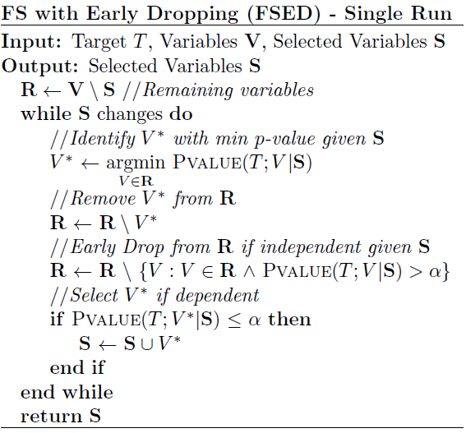
Forward-Backward with Early Dropping (single run)
(Borboudakis & Tsamardinos, 2017)
Need to compute p-values with all other remaining features for each selection
End of forward phase:
False positives: OtherCarCost
False negatives: Mileage, VehicleYear
:Target
:Selected
:dropped

Slide 44
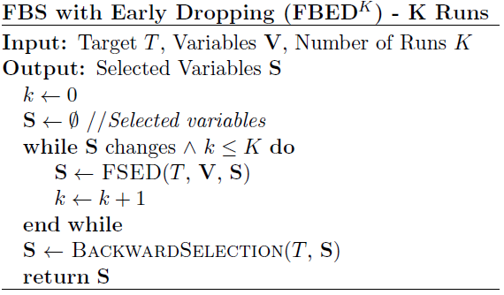
Forward-Backward with Early Dropping (multiple runs)
(Borboudakis & Tsamardinos, 2017)
False positives: none
False negatives: none
:Target
:Selected
:dropped

Slide 45
Forward-Backward with Early Dropping
Suitable when one has the statistical power to condition on all the selected features
Theorem: FBED¹ returns the Markov Blanket of T in distributions faithful to a Bayesian Network
Theorem: FBED∞ returns the Markov Blanket of T in distributions faithful to a Bayesian Network with latent variables
Complexity (in number of CI tests):
Worst-case, same as Forward-Backward
In practice, much faster

Slide 46
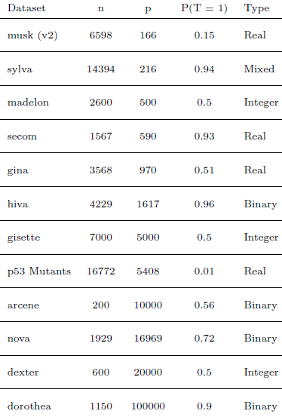
Experimental Evaluation
12 binary classification datasets
Sample size: 200 to 16772
Variable size: 166 to 100000
Conditional independence test: Based on logistic regression
Predictive model: L1-regularized logistic regression

Slide 47
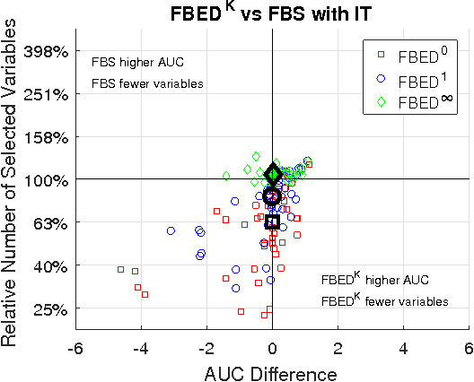
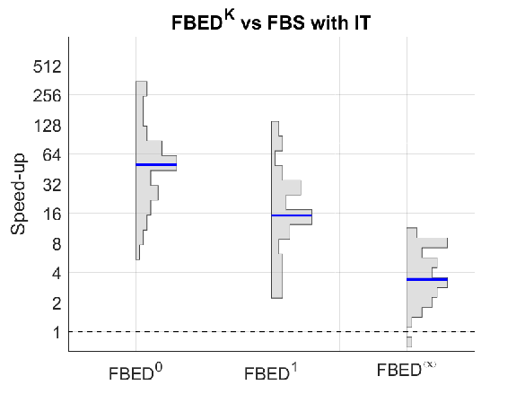
FBED vs FBS
Black points and Blue line: Median values
FBED has similar performance, while selecting fewer variables, and much faster
FBED∞ performs almost identically to FBS and ~2-8 times faster

Slide 48
Comparison with LASSO
LASSO vs Forward Selection methods when selecting same number of variables
There is no difference in performance

Slide 49
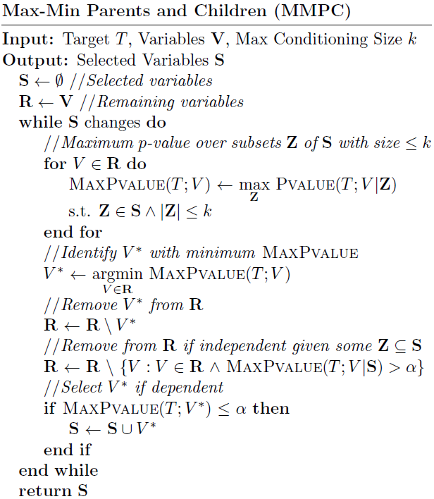
Max-Min Parents and Children: Conditioning on Subsets
(Tsamardinos et al., 2003b)
Need to compute p-values with all other remaining features for each new subset of S of size k
End of forward phase:
False positives: OtherCarCost, for k = 2 all white nodes
False negatives: Mileage, VehicleYear
k = 2 in this example

Slide 50
The symmetry correction
MMPC(T) will return {A, C} in the example on the right
MMPC will return a superset of the neighbors
B won’t be selected
Conditioning on subsets of {A}, C also enters selection
Theoretical (symmetry) correction to remove false positive:
Run MMPC(X) for all X returned in MMPC(T)
Keep only those where T ∈ MMPC(T)
Symmetry correction guarantees to find exactly the neighbor set
In practice: not worth the extra computation
T
B
A
C

Slide 51
Max-Min Parents and Children (MMPC)
Suitable when one has the statistical power to condition only up to k features
Theorem: MMPC (with symmetry correction and large-enough k) returns the neighbors (parents and children) of T in distributions faithful to a Bayesian Network with latent variables
Returns a small superset without the symmetry correction
Simple extensions (MMMB) return the full Markov Blanket
Complexity (in number of CI tests): O(n⋅ s^{k})
Typically, conditioning only on k = 3,4 suffices for excellent results
Max-Min Heuristic: select the variable that has the largest minimum conditional association (or smallest maximum p-value) with T (conditioned on all possible subsets of the selected features)
Another interpretation: smallest maximum p-value minimizes a bound on the False Discovery Rate of neighbors (Tsamardinos & Brown, 2008)

Slide 52
Experimental Evaluation
The MMPC algorithm has been extensively tested against several competitors in large scale, comparative experiments, including:
Binary classification tasks
Multi-class classification tasks
Time-to-even regression tasks
Temporal data
MMPC and have always performed equally well or better than the its competitors, often returning more parsimonious models

Slide 53
MMPC on binary classification tasks (Aliferis et al., JMLR 2010)
Binary classification tasks
Experimentation protocol: nested cross validation
Performance metric: Area Under the Curve (AUC)
Competitors: 43 different algorithms and variants, including
Least Angle Regression variable Selection (LARS)
Random Forest variable selection
Recursive Feature Elimination (RFE)
Datasets: 13 datasets representative of domains in which feature selection is essential (biology, medicine, economics, ecology, digit recognition)
Results: MMPC and the other feature selection methods inspired by (local) causal learning principles demonstrated to provide significantly more compact feature sets while at the same time being on par or outperforming the competitors included in the analysis (Table 3 in Aliferis et al., JMLR 2010).

Slide 54
MMPC on survival analysis (Lagani and Tsamardinos, Bioinformatics 2010)
Time-to-event (survival) analysis: trying to predict the risk of an outcome that did not arise in all available samples (censored targets)
Experimentation protocol: nested cross validation
Performance metric: Concordance Index (CI). Similar to AUC, specific for censored targets
MMPC is equipped with a Conditional Independent Test (CIT) able to model censored targets
Competitors: 6 feature selection algorithms specifically devised for survival analysis
Datasets: 6 high-dimensional gene-expression datasets, with sample size ranging from 78 to 295 cases and from 70 to 8810 candidate predictors
Results: Survival MMPC (SMMPC) outperforms all feature selection methods returning a manageable number of features. Methods like univariate selection and no selection produce slightly better results, however at the cost of including thousands of predictors in the models.

Slide 55
MMPC on multi-class classification tasks (Lagani et al., CSBJ 2010)
Multi-class classification tasks
Experimentation protocol: nested cross validation
Performance metric: Accuracy
MMPC is equipped with a CIT able to model multi-class outcomes by using multinomial logistic regression
Competitors: Lasso and MMPC equipped with standard conditional independence tests
Datasets: 7 high-dimensional gene-expression datasets, each with <200 cases and >12000 candidate predictors
Results: the multinomial-regression CIT outperforms standard CIT for multi-class outcomes. Lasso performs slightly better than MMPC (in a non-statistically significant way), while returning at least four times as many variables

Slide 56
Statistically Equivalent Signatures (SES, Lagani et al., JSS 2017, in press)
Assessing whether the signatures returned by SES are indeed equivalent
Experimentation protocol: splitting the data multiple times in training and test sets; hyper-parameters optimized through cross-validation on the training set.
One models for each signature is applied on the test set in order to compare performances from different signatures among each other
Competitors: the Lasso algorithms
Datasets: three datasets from separate domains and with different types of outcome: binary, continuous and time-to-event, respectively
Results: the signatures returned by are indeed equivalent, showing a coefficient of variation (ratio between std. dev. and mean) in their performance below 0.05. No statistically significant difference with the performance from Lasso.

Slide 57
SES on temporal data (Tsagris et al., BMC Bioinformatics,submitted)
SES is an extension of MMPC for multiple solutions
Temporal data contain variables that are measured over time. Four scenario can be defined, depending on:
The outcome is static or varying over time
The measurement are performed on the same subjects (longitudinal data) or on different ones
For each of these scenarios we devised a CIT to be equipped with constraint based feature selection or causal discovery algorithms
Competitors: Lasso algorithms specifically devised for the considered scenarios; Lasso not convex on this problems
Datasets: at least 6 gene expression microarray datasets for each scenarios, obtained after having extensively searched over all datasets collected in the Gene Expression Omnibus (GEO) repository
Results: SES easily scales on thousands of variables in the scenario having time dependent outcome and longitudinal data, while the corresponding lasso algorithm rapidly become too computationally demanding. On all other scenarios SES and Lasso have comparable results.

Slide 58
Practical advise and implementations

Slide 59
My advise to Practitioners
Good choice to try for most cases
Lasso (Tibshirani, 1996)
Large sample, very few features
Use exhaustive search
Large sample, few features
Use exact methods (Bertsimas et al., 2016)
Large sample relative to total number of features:
Use Backward Search
Large sample relative to the expected size of Markov Blanket
Use Forward-Backward with Early Dropping (FBED¹) and 2 runs (Borboudakis & Tsamardinos, 2017)
Small sample, can only condition with enough statistical power on k features
Use MMPC, MMMB (Tsamardinos et al., 2003b)
Use exact, statistically robust, non-linear tests if possible
Very efficient, Monte-Carlo Permutation-based tests for discrete variables available (Tsamardinos & Borboudakis, 2010)
After feature selection:
Do not use the models fit by the conditional independence tests (coefficients inflated)
Give problem to power classifiers (SVMs, Random Forests, Gradient Boosting Trees, GPs)

Slide 60
The MXM R Package
https://CRAN.R-project.org/package=MXM
Efficient implementations of (some) tests and feature selection algorithms
Algorithms: Backward Search, Forward-Backward, FBED, MMPC, MMMB, SES (for multiple solutions)
Conditional Independence Tests available
Target | Predicting features | Test
Continuous | Continuous | Pearson (robust) Correlation or Spearman
Continuous | Categorical/continuous | Linear (robust) regression or quantile (median) regression
Categorical | Categorical | G² test of independence
Proportions (between 0 and 1) | Categorical/continuous | Beta regression or linear (robust) regression or quantile (median) regression
Counts | Categorical/continuous | Poisson or Negative binomial regression
Zero inflated counts | Categorical/continuous | Zero inflated Poisson regression
Survival | Categorical/continuous | Cox, Weibull or exponential regression
Binary | Categorical/continuous | Logistic regression
Nominal | Categorical/continuous | Multinomial regression
Ordinal | Categorical/continuous | Ordinal regression
Clustered continuous, binary or counts | Continuous | Mixed models
Case-control | Categorical/continuous | Conditional logistic regression

Slide 61
Big volume data algorithms

Slide 62
Big Volume Data Challenges
Make computations local to data partitions
Stop computations as early as possible, when enough samples have been seen to make a decision

Slide 63
The Parallel Forward-Backward with Pruning* (PFBP)
Make computations local to data partitions
Compute statistics local to data partitions
Combine using meta-analysis techniques to global statistics
Communicate only statistics, not data
Stop computations as early as possible, when enough samples have been seen to make a decision
Early Dropping:
Same as in Forward-Backward with Early Dropping
Filters out features as soon as deemed conditionally independent of T
Early Stopping
Stop computing local statistics as soon as it is deemed that a feature will not be selected for inclusion/exclusion in the forward/backward phase
Early Return
Stop computations as soon as enough samples have been seen to determine a “good enough” feature for inclusion/exclusion
* In Progress. Joint work with Vassilis Christophides, Pavlos Katsogridakis and Polyvios Pratikakis

Slide 64
The Parallel Forward Backward with Pruning Algorithm (PFBP)
Low communication cost
Only need to communicate local p-values
Highly parallel
Processing data blocks independently
Scales to many variables
Early dropping
Scales sub-linearly with sample size
Early stopping
Early return
Returns predictive model without additional computational overhead

Slide 65
Experiment: Scalability
1000 Variables
100K Samples
10K Variables, 1M Samples
Data from simulated Bayesian networks
Maximum features to select set to 50
PFBP scales sublinearly with sample size and features
PFBP parallelizes with number of machines / cores

Slide 66
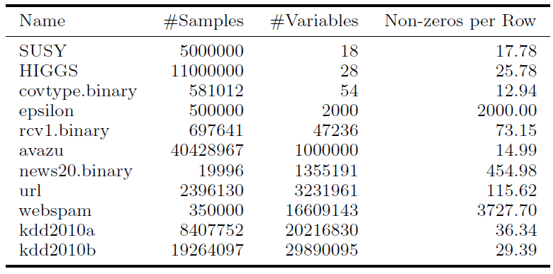
Experiment: Comparative Evaluation
Cluster: 4 worker machines (12 cores each), 1 master

Slide 67
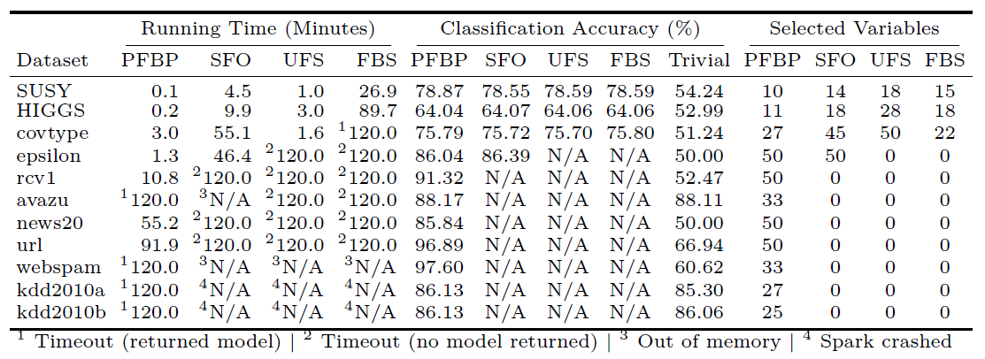
Experiment: Comparative Evaluation
UFS and FBS: Univariate and Forward-backward selection using parallel logistic regression
Single Feature Optimization (SFO): State-of-the-art forward-selection for Big Data
PFBP always returns solution, competitors timeout or crash
PFBP faster than competitors (except vs UFS on covtype)
PFBP has same predictive performance

Slide 68
Early Dropping, Stopping and Return
500K samples, 600K variables, dense (1.2 TB)

Slide 69
A Qualitative Comparison with Lasso
 | Lasso | Causal-Based
Problem definition | Maximize fit, minimize l₁ norm | Maximize fit, minimize l₀ norm
Parametric assumptions | Assumes model is linear w.r.t. the parameters | Whatever parametric assumptions made by the conditional independence test
Non-parametric assumptions | None | Distribution faithful to a causal model (Bayesian Network or Maximal Ancestral Graph)
Complexity | Convex for most problems, but not all (e.g., time-course data) | Remains the same in terms of number of tests, just substitute a different test
Scalability | Scales well with features when problem is convex | Scales well with features in terms of the number of tests
Parallelization for Big Data | Easily parallelized vertically | Hybrid parallelization (vertically and horizontally)
Number of features | Typically selects more features | Typically, selects fewer features
Predictive performance | Same predictive performance for the same number of selected features | Same predictive performance for the same number of selected features
Data types | Not generally applicable | Applicable to anything for which there is an independence test

Slide 70
concluding

Slide 71
Conclusions
Feature Selection is arguably the main tool for knowledge discovery
Causal models help understand the feature selection problem, in a non-parametric way
Causally inspired algorithms:
Provide theoretical guarantees under non-parametric assumptions
Applicable to any type of data for which a conditional independence test is available
Scale up to tens of millions of features and tens of millions of rows (Big Volume Data)
Competitive predictive performance against alternatives (e.g., Lasso)
Can find multiple, statistically-equivalent solutions
Solution(s) has intuitive causal interpretation
Robust, efficient implementations available, MXM R package

Slide 72
Acknowledgements
Mens X Machina Group
www.mensxmachina.org
Hosting: University of Crete
Current Funding: This project has received funding from the European Research Council (ERC) under the European Union’s Seventh Framework Programme (FP/2007-2013), grant agreement No 617393
Former colleagues: Constantine Aliferis, Alexander Statnikov
Recent work main contributions:
Giorgos Borboudakis
Vincenzo Lagani
Other co-authors in the papers

Slide 73
References
Aliferis, Constantin F., et al. "Local causal and markov blanket induction for causal discovery and feature selection for classification part i: Algorithms and empirical evaluation." Journal of Machine Learning Research 11.Jan (2010): 171-234.
Bertsimas, D., King, A. and Mazumder, R., 2016. Best subset selection via a modern optimization lens. The Annals of Statistics, 44(2), pp.813-852.
Borboudakis, G. and Tsamardinos, I., 2017. Forward-Backward Selection with Early Dropping. arXiv preprint arXiv:1705.10770.
Kohavi, R. and John, G.H., 1997. Wrappers for feature subset selection. Artificial intelligence, 97(1-2), pp.273-324.
Lagani, V., Athineou, G., Farcomeni, A., Tsagris, M. and Tsamardinos, I., 2017. Feature Selection with the R Package MXM: Discovering Statistically-Equivalent Feature Subsets. Journal of Statistical Software (in press).
Lagani, Vincenzo, George Kortas, and Ioannis Tsamardinos. "Biomarker signature identification in “omics” data with multi-class outcome." Computational and structural biotechnology journal 6.7 (2013): 1-7.
Lagani, Vincenzo, and Ioannis Tsamardinos. "Structure-based variable selection for survival data." Bioinformatics 26.15 (2010): 1887-1894.
Margaritis, D. and Thrun, S., 2000. Bayesian network induction via local neighborhoods. In Advances in neural information processing systems (pp. 505-511).
Pearl, J., 1988. Probabilistic reasoning in intelligent systems: networks of plausible inference. Morgan Kaufmann.
Peña, J.M., Nilsson, R., Björkegren, J. and Tegnér, J., 2007. Towards scalable and data efficient learning of Markov boundaries. International Journal of Approximate Reasoning, 45(2), pp.211-232.
Statnikov, A., Lytkin, N.I., Lemeire, J. and Aliferis, C.F., 2013. Algorithms for discovery of multiple Markov boundaries. Journal of Machine Learning Research, 14(Feb), pp.499-566.
Tsagris, M., Lagani, V., Tsamardinos, I. Feature Selection for high dimensional temporal data. Submitted to BMC Bioinformatics
Tibshirani, R., 1996. Regression shrinkage and selection via the lasso. Journal of the Royal Statistical Society. Series B (Methodological), pp.267-288.
Tsamardinos, I., Aliferis, C.F., and Statnikov, A.R., 2003a, May. Algorithms for Large Scale Markov Blanket Discovery. In FLAIRS conference (Vol. 2, pp. 376-380).
Tsamardinos, I., Aliferis, C.F. and Statnikov, A., 2003b, August. Time and sample efficient discovery of Markov blankets and direct causal relations. In Proceedings of the ninth ACM SIGKDD international conference on Knowledge discovery and data mining (pp. 673-678). ACM.
Tsamardinos, I. and Brown, L.E., 2008, July. Bounding the False Discovery Rate in Local Bayesian Network Learning. In AAAI (pp. 1100-1105).
Tsamardinos, I. and Borboudakis, G., 2010. Permutation testing improves Bayesian network learning. Machine Learning and Knowledge Discovery in Databases, pp.322-337.
Tsamardinos, I. and Lagani, V. and Pappas, D., 2012. Discovering Multiple, Equivalent Biomarker Signature. In 7th conference of the Hellenic Society for Computational Biology and Bioinformatics.
Welch, W.J., 1982. Algorithmic complexity: three NP-hard problems in computational statistics. Journal of Statistical Computation and Simulation, 15(1), pp.17-25.

