Slide 1
On Scoring Maximal Ancestral Graphs with the Max-Min Hill Climbing Algorithm Konstantinos Tsirlis, Vincenzo Lagani, Sofia Triantafillou and Ioannis Tsamardinos Associate Professor, Computer Science Department, University of Crete Visiting Professor, University of Huddersfield CEO and Co-Founder, Gnosis Data Analysis (Gnosis DA)
ACM SIGKDD 2017: Workshop on Causal Discovery

Slide 2
Outline
We consider the problem of causal structure learning in the presence of latent confounders.
We present the Max-Min Hill-Climbing for MAGs (M³HC) algorithm, an extension of the MMHC method able to deal with latent confounders in continuous variables.
We compare with GSMAG, a greedy-search algorithm for MAGs, and (c)FCI, a prototypical constraint-based algorithm for MAGs.
Notes:
We simulate continuous data that follow a multivariate Gaussian distribution.
We build Max-Min Hill-Climbing for MAGs (M³HC) upon an existing constraint-based and an existing score-based learning algorithm creating a hybrid method with two phases. Essentially extending MMHC from DAGs to MAGs.
We first use a local discovery constraint-based algorithm called Max-Min Parents and Children (MMPC) to restrict the search space of the possible admissible pairs of the second (scoring) phase.
We then use a constraint greedy search, Hill-Climbing with the Max-Min heuristic, to find the best scoring MAG.
Residual Iterative Conditional Fitting (RICF) is used to obtain MLE parameters for a MAG and score the graph.
We use decomposition results designed for Semi Markov Causal Models to implement a more efficient scoring search phase.
We compare to GSMAG, the algorithm on which we built upon our algorithm (an unrestricted greedy search algorithm), as well as to FCI and cFCI, the two standard/prototypical constraint-based algorithms.

Slide 3
Causal Structure Learning
Structure learning is a model selection problem in which we estimate or learn a graph that best describes the dependencies between variables in a given data set.
Causal structure learning is a special case where we try to learn a graph whose dependencies between variables are of causal meaning.
Basic assumptions:
Causal Markov Condition: A graph G and a probability distribution P satisfy the Causal Markov Condition if and only if for every W in V, W is independent of V\(Descendants(W) ∪ Parents(W)) given Parents(W).
Faithfulness Condition: <G, P> satisfies the Faithfulness Condition if and only if every conditional independence relation true in P is entailed by the Causal Markov Condition applied to G.
Notes:
Some independencies are determined explicitly by the Causal Markov Condition, others using probability theory.
All independencies in J can be identified in G using the graphical criterion of d-separation.

Slide 4
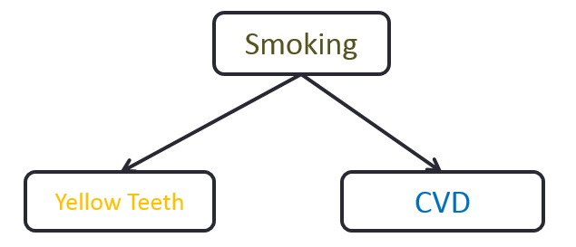
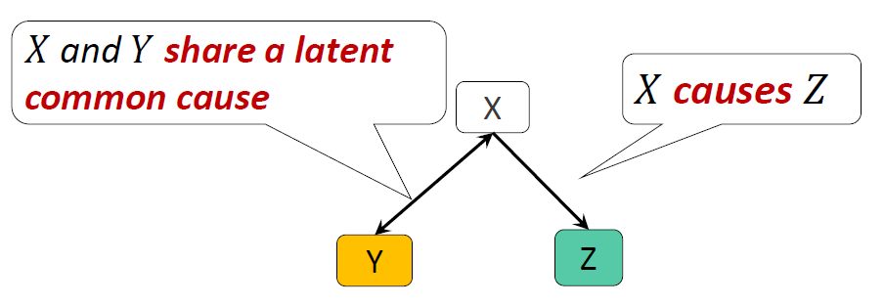
Maximal Ancestral Graphs
Directed Acyclic Graphs (DAGs) are one of the simplest types of (causal) graphs.
Nodes denote measured variables.
Edges denote direct causal relations.
A causal DAG G and a faithful probability distribution P constitute a Causal Bayesian network (CBN).
However they require causal sufficiency, i.e. the absence of latent confounders.
A pretty unrealistic requirement in real life data sets.
MAGs are an extension of DAGs that allow modelling of causally insufficient systems, i.e. systems with latent confounders. They are also closed under marginalization.
Notes:
- MAGs’ causal semantics are more complicated than DAGs’: directed edges denote causal ancestry, but the relation is not necessarily direct, and bi-directed edges denote the existence of confounding.
- Hence maximal ancestral graphs are maximal in the sense that no additional edge may be added to the graph without changing the independence model.

Slide 5
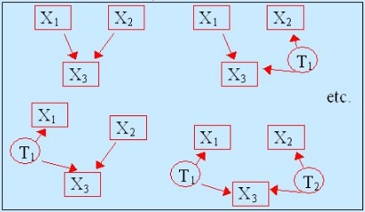
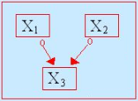
Partial Ancestral Graphs
A Partial Ancestral Graph (PAG) represents the Markov equivalence class of all the statistically equivalent MAGs by using a special notation (○) for edge endpoints that cannot be determined.
MAGs
PAG
Pictures taken from Richard Scheines
Notes:
- MAGs’ causal semantics are more complicated than DAGs’: directed edges denote causal ancestry, but the relation is not necessarily direct, and bi-directed edges denote the existence of confounding.
- Hence maximal ancestral graphs are maximal in the sense that no additional edge may be added to the graph without changing the independence model.

Slide 6
Types of Causal Structure Learning
Constraint-based methods: Utilize appropriate statistical tests of conditional independence to find conditional independencies that hold between variables in graph G. Each conditional independence corresponds to an m(d)-separation constraint.
Score-based methods: Search for the graph G that maximizes a scoring function that reflects how well the graph fits the data. Two desirable properties of a scoring function is to be score-equivalent and decomposable, such as the regularized log-likelihood, e.g. the BIC (Schwarz, 1978).
Hybrid methods: They usually consist of at least one constraint-based phase and one score-based phase capitalizing the benefits of both pure methods.
Example: Max-Min Hill-Climbing (MMHC)
Numerous algorithms from both types of methods exist that learn DAGs.
Notes:
Constraint-based algorithms try to eliminate all graphs that are inconsistent with the observed constraints, and ultimately return only the statistically equivalent graphs consistent with all the tests.
score-equivalent, if it assigns the same value to all DAGs within the same Markov equivalence class.
A score is decomposable, if it can be computed as a sum of terms (typically one term for each node) depending only on local features of the causal structure. A decomposable score helps to speed up the computation of scores during the search process.

Slide 7
Learning MAGs through score-based and hybrid methods
Learning MAGs though was typically done with constraint-based methods, because there were no known methods for scoring MAGs with efficiency.
Theory and algorithms for computing MAGs score appeared only recently
Nowzohour et al. 2015
Triantafillou et al. 2016
Our goal: Extending the hybrid method Max-Min Hill Climbing (MMHC) for learning MAGs and contrasting its performances against FCI and cFCI, two prototypical constraint-based methods for causally insufficient systems.
Notes:
score-equivalent, if it assigns the same value to all DAGs within the same Markov equivalence class.
A score is decomposable, if it can be computed as a sum of terms (typically one term for each node) depending only on local features of the causal structure. A decomposable score helps to speed up the computation of scores during the search process.
The BIC criterion for a MAG model was developed by Richardson et al. 2002.
Nowzohour et al. (2015) demonstrated that $lG(\hat{Σ}|G)$ can be decomposed according to the c-components of G.

Slide 8
Max-Min Hill-Climbing (MMHC)
MMHC (Tsamardinos et al., 2006) is a hybrid algorithm consisting of a constraint-based skeleton identification phase followed by a score-based edge orientation phase.
Assumptions: (1) Causal Markov Condition, (2) Acyclicity, (3) Causal Faithfulness, and (4) Causal Sufficiency.
Skeleton Identification Phase: MMHC learns the CPDAG skeleton using the constraint-based Max-Min Parents and Children (MMPC) algorithm.
Edge Orientation Phase: Performs a score-based hill-climbing to determine the edge orientations, searching for the DAG that best fits the data according to a scoring function.

Slide 9
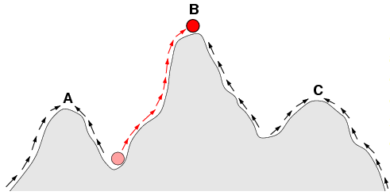
Max-Min Hill-Climbing (MMHC)
The superiority of MMHC over all other existing algorithms in causally sufficient systems is due to its hybrid nature.
It utilizes a constraint-based approach, which are naturally more reliable in the skeleton identification phase, to constraint the DAG search space.
And then it utilizes a score-based approach, which naturally handles the orientation phase more reliably, to orient the edges.
This superiority of MMHC motivated the interest to extend it to causally insufficient systems.
Hill-Climbing
Picture taken from Fernando Sancho Caparrini

Slide 10
Max-Min Hill-Climbing for MAGs (M³HC)
M³HC is an extension of MMHC in causally insufficient systems.
Just like MMHC, M³HC is a hybrid algorithm consisting of a constraint-based skeleton identification phase followed by a score-based phase.
Assumptions: (1) Causal Markov Condition, (2) Acyclicity, (3) causal faithfulness.
Skeleton Identification Phase: M³HC learns the MAG skeleton using the constraint-based Max-Min Parents and Children (MMPC) algorithm.
The output of MMPC will be the set of all and only admissible pairs of the second phase, effectively restricting the MAG search space into all the possible actions of only these admissible pairs.
Notes:
To sum up…
- The output of MMPC will be the set of admissible pairs in the second phase, restricting the MAG search space into all the possible actions of only these admissible pairs.

Slide 11
Max-Min Hill-Climbing for MAGs (M³HC)
“Orientation” Phase: Starting from the empty graph performs a score-based hill-climbing to build the skeleton alongside determining the edge orientations, essentially searching for the MAG that best fits the data according to BIC criterion.
When there is no improvement in the score after 50 iterations the algorithms terminate and the top scored MAG is returned as the final output MAG.
Notes:
- The “orientation phase” is loosely defined like that, it’s not 100% accurate though. In this phase we build in parallel the skeleton together with the best fit orientations, but also having the potential to change the skeleton defined from the first phase. We call the second phase “orientation phase” just to sync with the standard bibliography.

Slide 12
Max-Min Parents and Children Algorithm (MMPC)
MMPC is a constraint-based local discovery algorithm used to identify relations with a target variable, without having the ability to identify the orientation of the edges.
MMPC constitutes the first phase of the M³HC algorithm, used to restrict the space of possible admissible pairs for scoring.
“Max-Min” Heuristic: Select the variable that maximizes the minimum association with the target variable T relative to the Candidates Parents and Children of the target variable.
Algorithm’s Output: A list of variables related to the target variable, either being Parents or Children (PC) of that target variable, without being able to distinguish between the two potentialities.
Notes:
- “Max-Min” refers to the heuristic used, “Parents and Children” refers to the algorithm’s output.
- Even though MMPC was developed for causally sufficient contexts, it tends to perform surprisingly well on real data where causal sufficiency is not ensured; this indicates that it should be quite effective in identifying a good approximation of the target variable’s neighborhood.

Slide 13
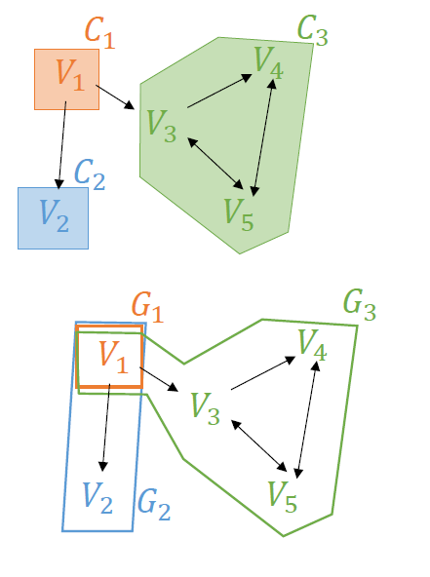
Scoring MAGs
The BIC criterion for a MAG model (Richardson et al. 2002) is:
Nowzohour et al. (2015) demonstrated that $lG(\hat{Σ}|G)$ can be decomposed according to the c-components of G.
The c-components of a graph G correspond to the connected components of its bi-directed part, i.e., the graph stemming from G after the removal of all directed edges.
Likelihood can be decomposed to the likelihood of the c-components.
$lG(\hat{Σ}|G)=−\frac{N}{2}\sum_{k}{sk}$
𝐺_{𝐾}: The restriction of 𝐺 on 𝐶_{𝑘} ∪ 𝑃𝑎_{𝐺}(𝐶_{𝑘})
Notes:
- MAG’s causal semantics are more complicated than DAG’s: directed edges denote causal ancestry, but the relation is not necessarily direct, and bi-directed edges denote the existence of confounding.
- l_{G}(Σ,G) is G likelihood, while V and E are the number of vertices and edges in G, respectively. The Σ is the maximum likelihood estimate of the covariance matrix.
- The likelihood of G then becomes $lG(\hat{Σ}|G)=−\frac{N}{2}\sum_{k}{sk}$ , where each s_{k} correspond to a c-component and can be computed with the closed formula shown in the slide.
…where C_{k} are the nodes in the c-component k, while Pa_{G}(C_{k}) are the parents of nodes in C_{k}, G_{k} represents the marginalization of G to nodes in C_{k} ∪ Pa_{G}(C_{k}), and σ²_{kj} is the diagonal entry of $\hat{Σ}$_{Gk} that corresponds to the parent node k.

Slide 14
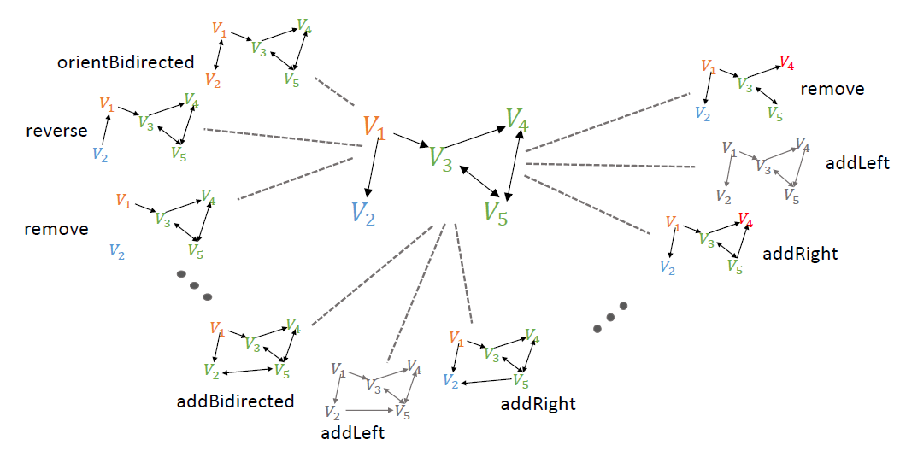
Greedy Search
Start from the empty graph.
In each iteration, try all possible actions that do not create (almost) cycles and choose the one that optimizes the BIC score.
Re-compute the score only for connected components that have changed.
Split connected components when a ↔ edge is removed / becomes directed.
Merge connected components when a ↔ edge is added.
Incrementally re-compute ancestral relationships when a →, ← edge is added.
This idea constitutes the basis for the Greedy Search MAG (GSMAG) algorithm (Triantafillou et al. 2016).
Notes:
- Even though MMPC was developed for causally sufficient contexts, it tends to perform surprisingly well on real data where causal sufficiency is not ensured; this indicates that it should be quite effective in identifying a good approximation of the target variable’s neighborhood.

Slide 15
Constrained Greedy Search
The number of possible MAGs increases very fast as we increase variable size.
Scoring all possible MAGs becomes intractable.
Constraining the MAG search space makes the scoring part more tractable.
So starting from the empty graph.
First use MMPC to constraint the MAG search space to consider only a subset of all possible actions.
Then in each iteration, try all possible actions from the set of admissible pairs that do not create (almost) cycles and choose the one that optimizes the BIC score.
Both M³HC and GSMAG were equipped with a TABU list in an effort to avoid suboptimal solutions (local optima).
Notes:
- The TABU list keeps the 100 candidate MAGs that best fit the data according to the scoring function, and prohibits reconsidering those solutions.

Slide 16
Competitors
Greedy Search MAG (GSMAG): A score-based greedy search algorithm. Essentially the unconstrained greedy search analog of M³HC. Starting from an empty graph, in each iteration, try all possible actions from all possible pairs in G that do not create (almost) cycles and choose the one that optimizes the BIC score.
FCI: FCI is the prototypical asymptotically correct constraint-based algorithm that identifies the PAG consistent with a data set. The algorithms work in two stages.
Skeleton identification stage: Starting from the full graph, the algorithm tries to identify a conditional independence for each pair of variables.
Orientation stage: Here the cached conditioning sets from the first stage are employed to orient the edges.
Conservative FCI: A modified FCI performing additional conditional independence tests during the orientation stage, resulting in less but more robust orientations, consistent with multiple conditional independencies.

Slide 17
Competitors
Other competitors: FCI+, RFCI, etc.
Possible state-of-the-art competitors: GFCI
Greedy FCI: GFCI is a combination of the Fast GES (FGES [CCD-FGES, 2016]) algorithm and the FCI algorithm [Spirtes, 1993] that improves upon the accuracy and efficiency of FCI.

Slide 18
Experimentation
2 hyper-parameters to specify
Significance Threshold α: 0.05 for sample sizes [100, 1000], 0.05x10⁻² for sample size 10000 and 0.05x10⁻⁴ for sample size 100000.
Maximum Conditioning Set: 10
6 different (overlapping but complementary) performance metrics
Structural Hamming Distance (Tsamardinos et al. 2006)
Running Time
Precision-Recall (Tillman et al. 2011)
# different (undirected) edges
# different endpoints (between the output PAG and the true PAG)
Notes:
- The maximum conditioning set was held fixed at 10 for all tests of conditional independence, which we believe is high enough given the sparseness of the DAGs we simulate.
- Here I need to mention that we first converted the output MAG to its PAG so that we are able to compare with (c)FCI’s output which is a PAG.
- Precision is the number of correct edges with correct orientation (or lack of orientation, when undirected) in the predicted PAG divided by the number of edges in the predicted PAG, while Recall is defined as the number of correct edges with correct orientation (or lack of orientation, when undirected) in the predicted PAG divided by the number of correct edges in the ground truth PAG.

Slide 19
Comparison of M³HC with GSMAG
1. Comparison of M³HC with GSMAG on randomly generated DAGs
50 randomly generated DAGs for all combinations below:
Variable size [10, 20, 50, 70].
Maximum number of parents [3, 5] (uniformly distributed).
Sample sizes [100, 1000, 10000, 100000].
# Latent variables [10%] of the variable size.

Slide 20
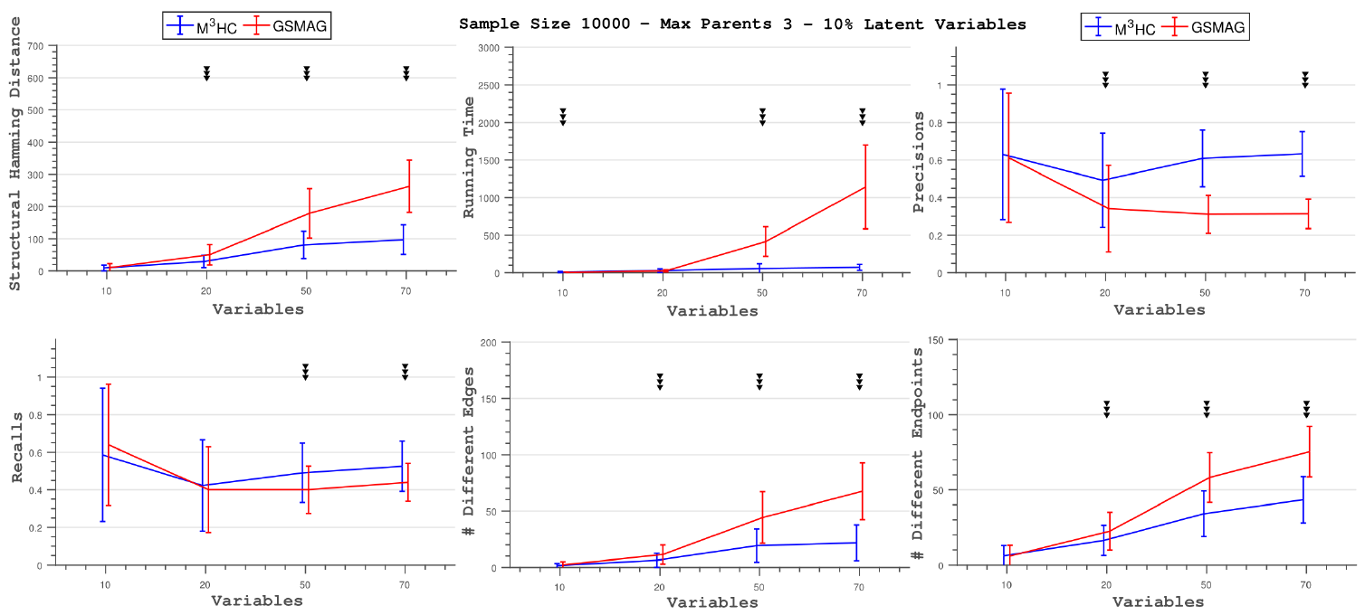
Comparison of M³HC with GSMAG
M³HC outperforms, often in a statistically significant way, GSMAG in the vast majority of the comparisons across almost all metric performances.
Results are qualitatively the same across all different sample sizes and across all different maximum parents.
Notes:
In general, the difference in the metric performances between M³HC and GSMAG increases along with the number of nodes in the network.

Slide 21
Comparison of M³HC with (c)FCI 1
2. Comparison of M³HC with (c)FCI on randomly generated DAGs
50 randomly generated DAGs (5 for variable size 800) for all combinations below:
Variable size [10, 20, 50, 100, 200, 400, 600, 800].
Maximum number of parents [3, 5] (uniformly distributed).
Sample sizes [100, 1000, 10000]
# Latent variables [10%, 30%] of the variable size. We experimented with 50% latent variables only for sample size 10000.

Slide 22
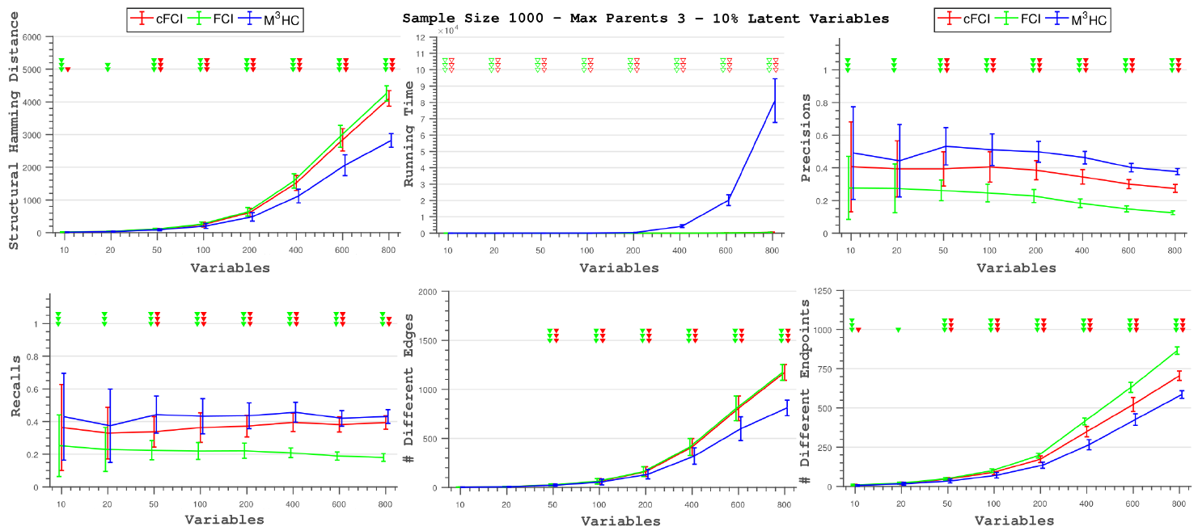
Comparison of M³HC with (c)FCI 1
M³HC outperforms, almost always in a statistically significant way, both FCI and cFCI in a big majority of comparisons and across all metric performances, except computation times.
In most comparisons the differences in structural hamming distance, number of different edges and number of different endpoints between M³HC and (c)FCI increases along with the number of nodes in the network.
Notes:
- In most comparisons the differences in structural hamming distance, number of different edges and number of different endpoints between M³HC and (c)FCI increases along with the number of nodes in the network.
…On the other hand the differences in precision and recall between M³HC and (c)FCI tend to be stable as we increase the number of nodes in the network.

Slide 23
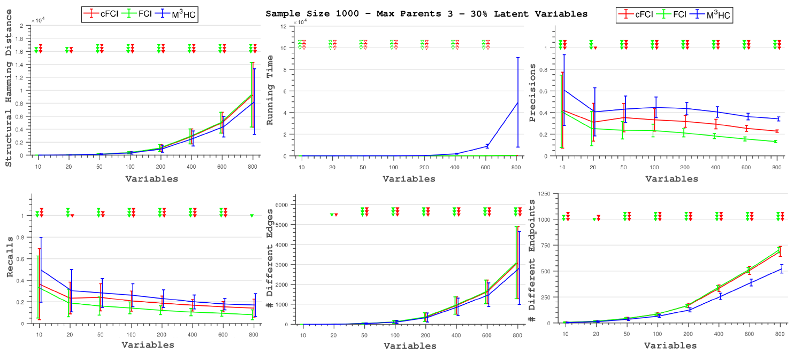
Comparison of M³HC with (c)FCI 1
…On the other hand the differences in precision and recall between M³HC and (c)FCI tend to be stable as we increase the number of nodes in the network.
Results are qualitatively the same across all different sample sizes, across all # of latent variables and across all different maximum parents.

Slide 24
Comparison of M³HC with (c)FCI 2
Comparison of M³HC with (c)FCI on the Insurance and the full Munin networks
50 randomly generated datasets for Insurance, 5 for full Munin.
Sample sizes [100, 10000] for Insurance, sample size 10000 for full Munin.
# Latent variables [10%, 30%] of the variable size for both.

Slide 25
Comparison of M³HC with (c)FCI 2
Results in the Insurance and the full Munin networks are again qualitatively the same, but with M³HC outperforming (c)FCI slightly more in some of the occasions.
An interesting difference between the randomly generated DAGs and the 2 networks is the smaller time differences between the algorithms in the full Munin networks (1041 variables).
Randomly generated DAGs with 800 variables: M³HC_{running time} ~ 200 cFCI_{running time}
Full Munin (10% latent variables): M³HC_{running time} ~ 2 cFCI_{running time}
Full Munin (30% latent variables): M³HC_{running time} ~ 2/3 cFCI_{running time}
Notes:
This difference in running times could be due to the fact that when we generated a random DAG, the parents spread in the network in a much more neat and symmetric fashion effectively creating less latent confounders when some of them are hidden, in comparison to the Munin network which has a much more irregular distribution of parents and children.

Slide 26
Conclusions
In this work we introduce M³HC, a hybrid algorithm for continuous data able to deal with latent confounders.
We contrast the proposed method against a score-based algorithm, namely GSMAG, and two prototypical constraint-based algorithms, FCI and cFCI, which also do not assume causal sufficiency.
M³HC mostly outperforms all 3 algorithms, often in a statistically significant way, while being much slower than (c)FCI.
This project has received funding from the European Research Council (ERC) under the European Union’s Seventh Framework Programme (FP/2007-2013) (grant agreement No 617393).

Slide 27
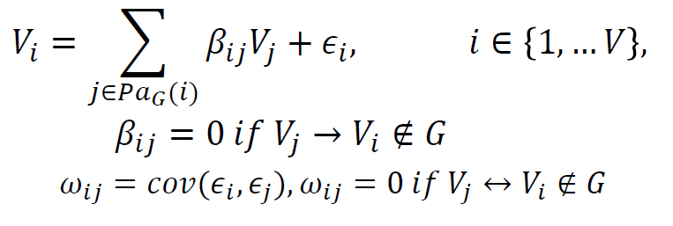
Causal Bayesian Networks
Under multivariate normality, a MAG 𝐺 defines a system of linear equations
After the first phase (MMPC), M³HC uses Residual Iterative Conditional Fitting (RICF) to identify the MLE parameters $\hat{β}$, $\hat{\text{ω}}$ of the system and to estimate the likelihood 𝐿_{𝐺}($\hat{β}$, $\hat{\text{ω}}$|𝐷).
It then uses BIC to score each (𝐺, $\hat{β}$, $\hat{\text{ω}}$).

Slide 28
Questions
//

